Slide 1
Background Information on the Eve of the Civil War
North vs. South

Slide 2
Set up your notes…
Using a ruler, divide your paper into a T-Chart, with a line down the middle.
As you go through the presentation, use each title to label each section of your notes. You will be quizzed on this information at a later date!
(Margin) | North | South
Other Names | notes notes notes notes notes notes notes notes notes notes | notes notes notes notes notes notes notes notes notes notes
Flags | notes notes notes notes notes notes notes notes notes notes | notes notes notes notes notes notes notes notes notes notes
# of States | notes notes notes notes notes notes notes notes notes notes | notes notes notes notes notes notes notes notes notes notes

Slide 3
OTHER NAMES
NORTH
Union
United States of America
Federals
U.S.A.
SOUTH
Confederacy
Confederate States of America
C.S.A.

Slide 4
FLAG
NORTH
Stars & Stripes
SOUTH
Stars & Bars
Find examples of the flags on the internet and
sketch them in your journal.

Slide 5
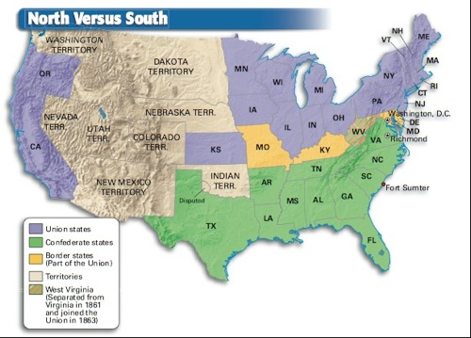
NUMBER OF STATES
NORTH
SOUTH

Slide 6
POPULATION
NORTH
SOUTH

Slide 7
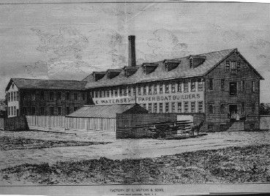
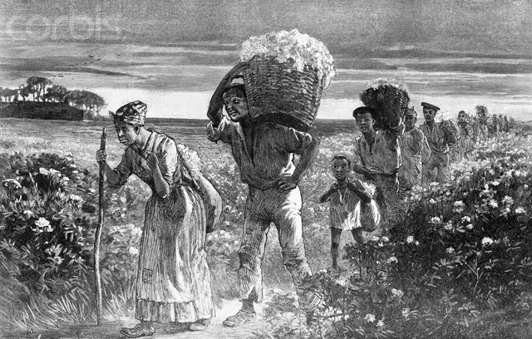
INDUSTRIAL DEVELOPMENT
NORTH
92% of the nation’s industries were in the North.
SOUTH
Very little industrial development, mostly an agrarian economy.

Slide 8
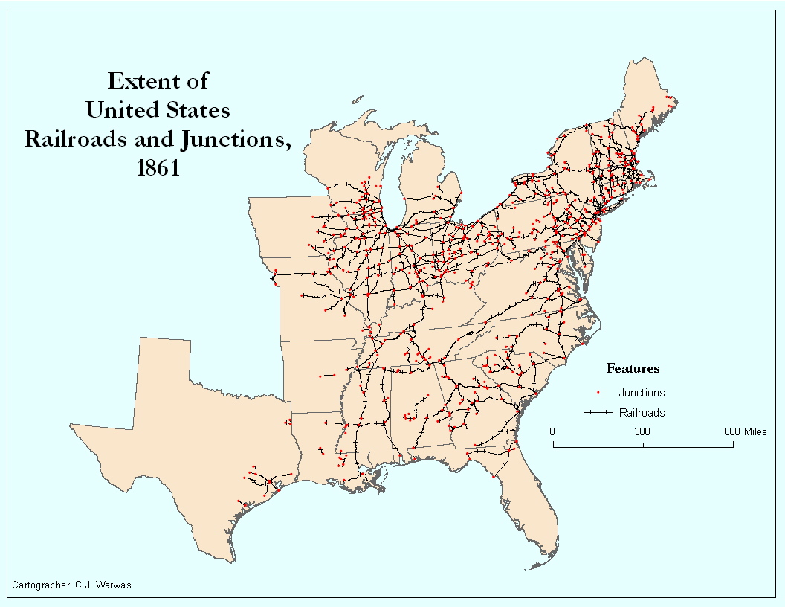
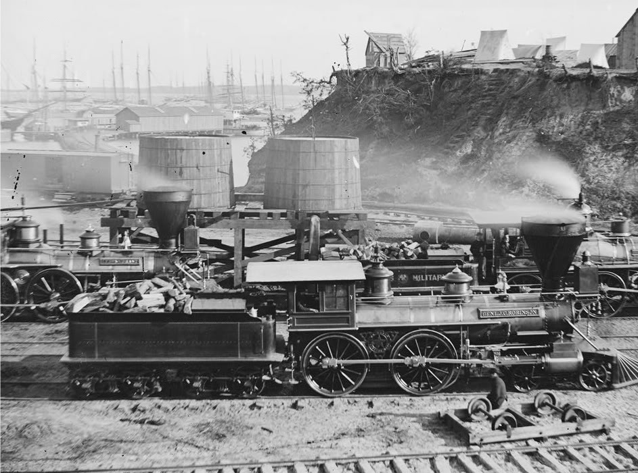
RAILROAD MILEAGE
NORTH
75% of the nation’s railroad mileage was in the North.
SOUTH
Significantly fewer railroads existed in the South.

Slide 9
FINANCIAL RESOURCES
NORTH
SOUTH

Slide 10
LEADERSHIP
NORTH
Abraham Lincoln has extensive experience as a lawyer, limited experience in Congress and virtually no military experience.
SOUTH
Jefferson Davis had been a senator from Mississippi and Secretary of War; he also had military experience during the Mexican-American War.

Slide 11
GENERALS
NORTH
Most were West Point graduates.
Few Union generals were effective in leading Union armies until Ulysses S. Grant’s rise in 1862-1864.
SOUTH
Perhaps the South’s greatest advantage.
Brilliant, bold military leaders from Virginia Military Institute (VMI), West Point and other academies.

Slide 12
STRATEGIES
NORTH
Bring the South back into the Union ASAP.
Never recognize the South’s independence or it’s “right” to leave the Union.
Strangle the South with a naval blockade (Anaconda Plan).
Defeat rebel armies, split South in two, and capture Richmond, VA.
SOUTH
Fight a defensive war until the Union no longer has the will to fight.
Stress how secession is a parallel with the 13 colonies pulling out of the British empire in 1776.
Capture Washington, D.C.

Slide 13
CAPITAL
NORTH
Washington, D.C.
SOUTH
Montgomery, Alabama for a brief period
Richmond, Virginia

Slide 14
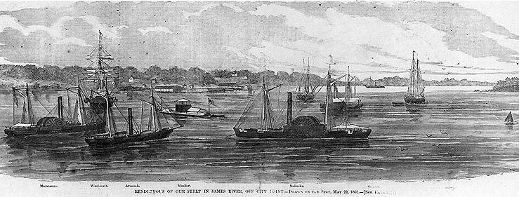
NAVAL POWER
NORTH
Large navy which grew even larger as the war progressed.
SOUTH
Virtually no navy at the start of the war.

Slide 15
CAUSE FOR FIGHTING
NORTH
To preserve the Union – at first.
Later, the emancipation of the slaves became a cause.
SOUTH
To gain independence.
To save the “Southern Way of Life” – which included slavery.

Slide 16
NAMES FOR TROOPS
NORTH
Federals
Yanks
Billy Yanks
Yankees
SOUTH
Rebels
Rebs
Confederates
Graybacks
Butternuts
Johnnies

Slide 17
INTANGIBLES
NORTH
Battles fought away from home.
Less skills in the military arts.
Thousands of immigrants fighting for no purpose that made sense to them.
Farm acreage: 65%, dominant crops – wheat and corn.
Divided politically (e.g., Copperheads)
SOUTH
Traditionally protecting their homes and way of life.
Fought on their own land, which they therefore knew better than their opponents.
Military tradition: nearly every male citizen skilled at riding horses and using rifles skillfully.
Violence was a traditional aspect of Southern society.

