Slide 1
America’s Economy: Full Steam Ahead
The Industrial & Transportation Revolutions

Slide 2
Words to Know
Textile: A type of cloth or woven fabric
Industry: Economic activity that processes raw materials to create goods in factories.
Manufacturing: Using machines, tools, and labor to produce goods to be used or sold.

Slide 3
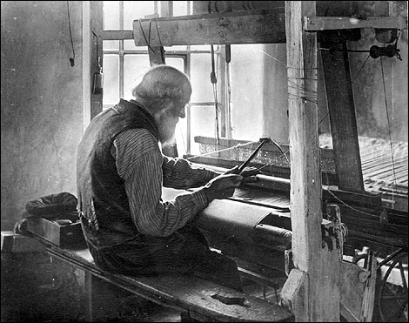
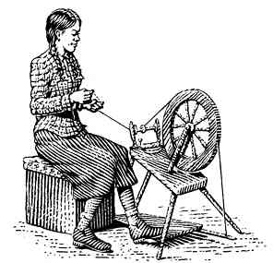
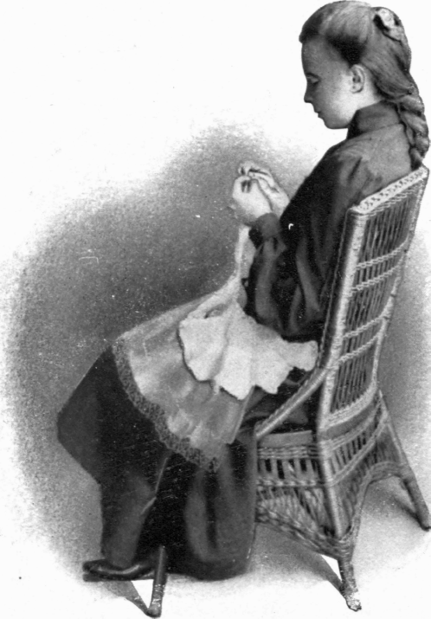
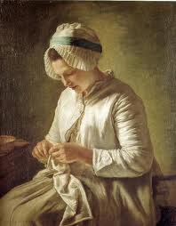
Based on the pictures you see, what can you infer about how and where clothing was made prior to the Industrial Revolution?

Slide 4
English Inventors Pave the Way
In the 1760’s, an Englishman named James Hargreaves built a machine called the spinning jenny to take the place of the spinning wheel.
A few years later, Edmund Cartwright invented a loom which could be run by water power.

Slide 5
The Birth of the Factory
The new machines were expensive and families could not afford to own them.
They were also too large to be operated in a home.
Also, they had to be located near a stream so they could be driven by the water wheel.
Before long, business men began creating factories in England to create woven fabrics, also known as textiles.

Slide 6
Machines Come to America
- England jealously guarded the secrets of her new textile machines so that no other country would benefit from them.
- In 1789 a man named Samuel Slater defied the laws and brought over the plans in his head! He started a cotton mill in R.I. and Mass. and others began shortly after.

Slide 7
The Industrial Revolution Gets a Boost!
In the early part of the 1800’s, the U.S. and Britain weren’t getting along, so President TJ decided to do something about it. Remember the “cursed Ograbme”?
Eventually the U.S. went to war with Britain, totally interfering with trade. This led to a boom in new factories that created many different goods.

Slide 8
New England Leads Way
The majority of early factories were located in New England for three main reasons:
Swift-rushing streams supplied needed water power.
Tough to farm so people were willing to work in the new factories.
Already had plenty of ships to transport the products of the factories.

Slide 9
The South Gets a Boost Too!
With rise of textile factories in the North, a Southern commodity suddenly became more valuable. What do you think it was?

Slide 10
Cotton Becomes King
One of the problems with producing cotton was that it was very time consuming because a worker had to pick the seeds out of each piece by hand. One man who visited the South saw this problem.
Eli Whitney

Slide 11
Cotton Becomes King
Eli Whitney saw how horribly the slaves were being treated and wanted to invent something to make their lives easier. His invention, the Cotton Gin, changed the South (and the nation) forever.

Slide 12
The Cotton Gin
The invention of the Cotton Gin quickly made cotton the world’s most profitable crop and it became the mainstay of the Southern economy.
It also had a consequence that Whitney had not foreseen. As cotton became more valuable and easier to produce, the South’s reliance on slavery increased rather than decreased as Whitney had hoped.

Slide 13
A New Need Arises
Increased cotton production in the South and increased production of manufactured goods in the factories in the North caused a new need to arise. What do you think that might have been?

Slide 14
Transportation Revolution
In 1806, Congress funded the construction of a National Road.
The invention of the steamboat by Robert Fulton in 1807 made water travel faster and easier.
The construction of the Erie Canal in 1817 and then others, made water transportation possible in places it had never been before.
Clipper ships made ocean travel faster making foreign trade more profitable.

Slide 15
Transportation Revolution
Railroads were being built at an amazing speed and by the 1840s railroads had become the North’s biggest business. By 1860, more than 20,000 miles of rail linked northern factories to cities hundreds of miles away.

Slide 16
The Railroad Boom
Year | Miles of Railroad Operated
1830 | 23
1835 | 1,098
1840 | 2,818
1845 | 4,633
1850 | 9,021
1855 | 18,374
1860 | 30,626

