Slide 1
Mystery #4
Question: Where are the “Halls of Montezuma”?
Answer:
Sources (2):
Connection to W.E.:

Slide 2
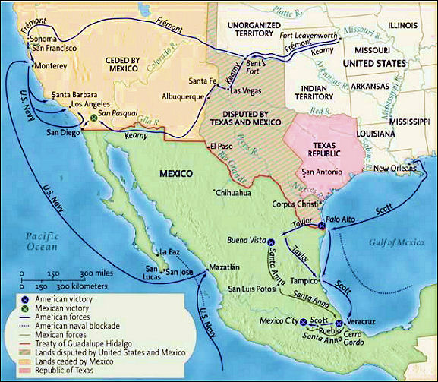
Mexican-American War: 1846-1848 United States vs. Mexico

Slide 3
Mexican War: The Causes

Slide 4
1. Mexico was insulted by Texas annexation.

Slide 5
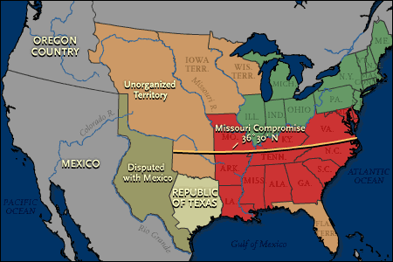
2. Argument over what river was the boundary of Texas and Mexico

Slide 6
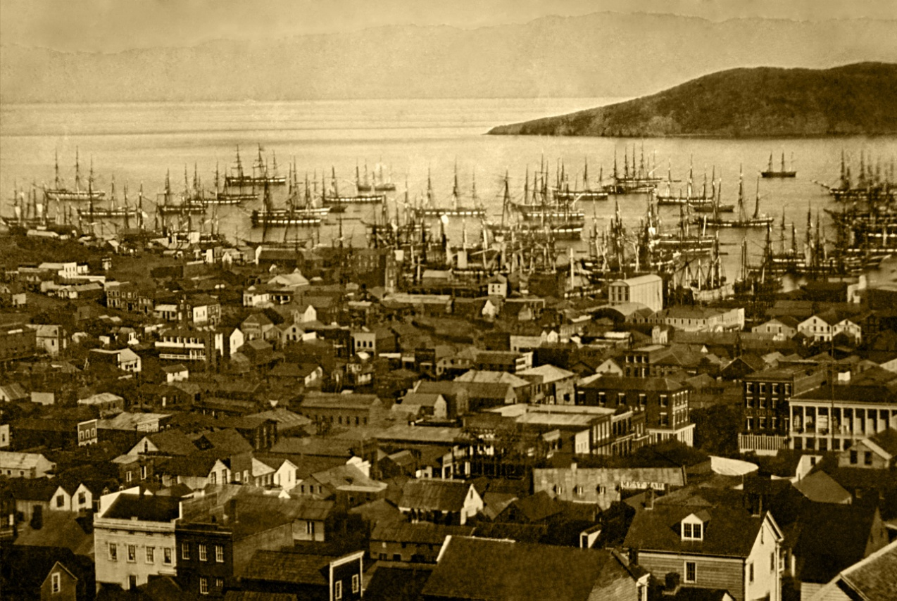
3. America wanted to buy San Francisco. (Location was crucial to trade in the Far East).

Slide 7
4. America offered $30 million to buy western lands.

Slide 8
Mexican War and Victory

Slide 9
1. “American blood was shed on American soil.” James K. Polk (Thornton Affair) Mexico argues the same thing.

Slide 10
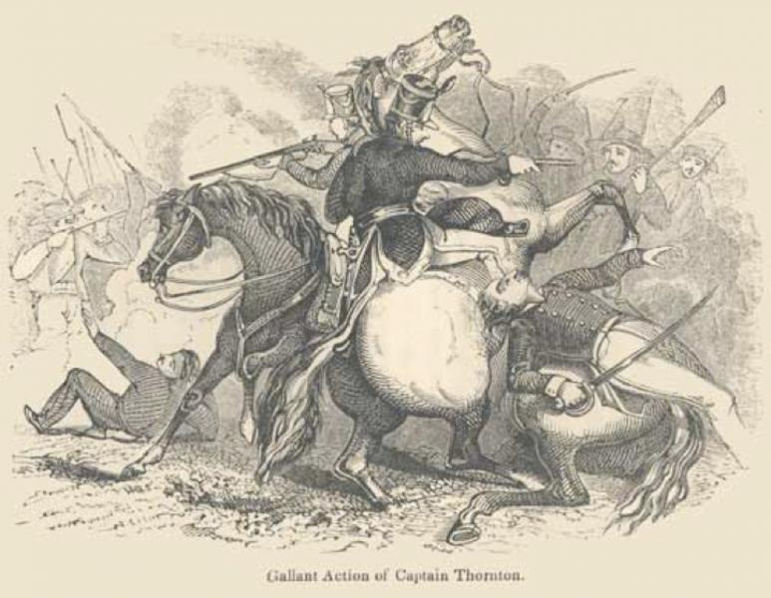
Thornton Affair

Slide 11
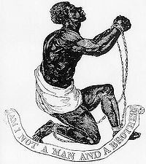
2. Abolitionists were against the war. (They did not want more slave states).

Slide 12
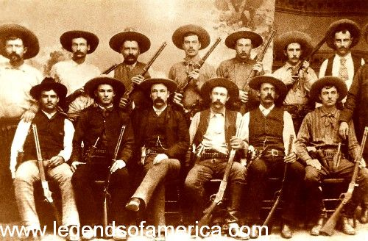
3. 5000 Texans joined the American army. Texas Rangers have a reputation as vicious fighters. (Los Diablo's Tejanos).

Slide 13
4. Total American Victory. Not much of a war at all.

Slide 14
Treaty of Guadalupe Hidalgo

Slide 15
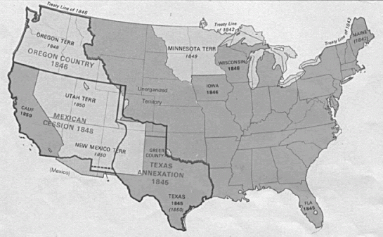
1. Rio Grande is the boundary of Texas.

Slide 16
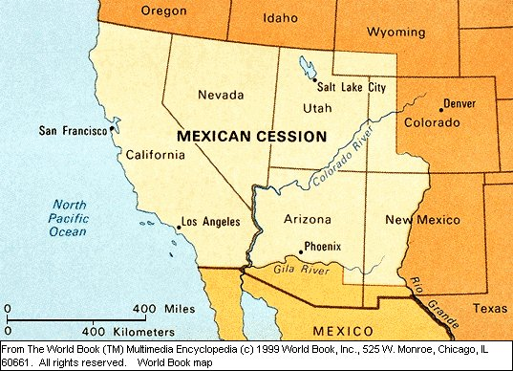
2. America gets Mexican land to California. (Right before the discovery of Gold).

Slide 17
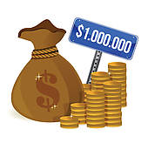
3. America gives Mexico $15 million.
X 15

Slide 18
4. Texas gets $10 million to give up land in New Mexico.

Slide 19
When you have completed your foldable, see your teacher to have it checked.

Slide 20
Your assignment (3 options)
Option 1: You and your partner create two political cartoons about anything related to the Mexican-American War. Cartoons can be pro or anti-war. One cartoon will be from the American perspective and one cartoon will be from the Mexican perspective.
*You will not be graded on artistic ability.

Slide 21
Your assignment (3 options)
Option 2: You and your partner write a newspaper editorial (opinion piece) about anything related to the Mexican-American War. You may choose to write from the American or Mexican perspective. The article must have a headline.
*May be written by hand or done digitally.

Slide 22
Your assignment (3 options)
Option 1: You and your partner will create a news broadcast about anything related to the Mexican-American War. Broadcasts can be pro or anti-war. Your broadcast can be from the American or the Mexican perspective.
*If you choose this option, you are responsible for all technological aspects, including getting the video to your teacher.

