Slide 1
A New Nation
1789-1800

Slide 2
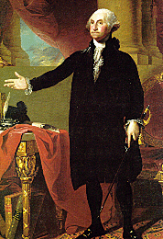
EVENTS OF THE NEW NATION
WASHINGTON INAUGURATED
“I WALK ON UNTRODDEN GROUND”

Slide 3
Washington was the unanimous choice for President
Adams was elected Vice-President with fewer
than half of the electors voting for him
The Constitution gave a framework from which to
establish the new government.
A lot of precedent was set during this time in
American History
Precedent - an example that becomes standard practice

Slide 4
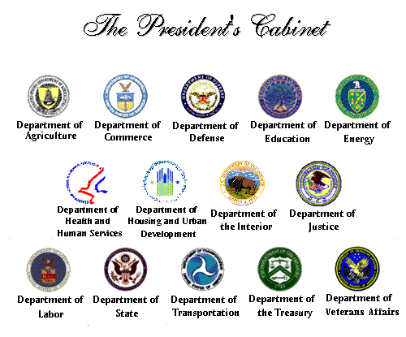
Washington's Cabinet
The Cabinet is head's of departments that help the President lead the nation. Example: Secretary of State Hillary Rodham Clinton

Slide 5
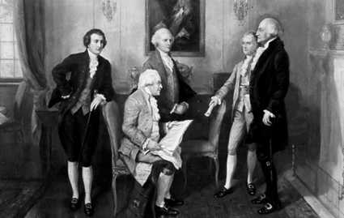
Washington’s First Cabinet: Hamilton (Treasury), Knox (War), Jefferson (Secretary of State), Jay (Supreme Court Chief Justice)

Slide 6
EVENTS OF THE NEW NATION
FINANCIAL PROBLEMS
WAR COSTS MONEY
NATION OWED $62 MILLION
STATES OWED $19 MILLION

Slide 7
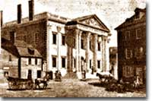
Hamilton's Financial Plan to Improve Nation's Finances
1. Pay off all war debts
2. Raise government revenues
3. Create a national bank.

Slide 8
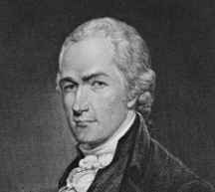
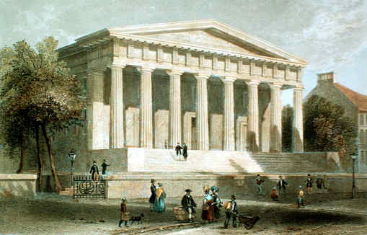
Hamilton’s Bank Plan
Use Bank of United States to pay off the war debt from the American Revolution

Slide 9
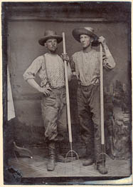
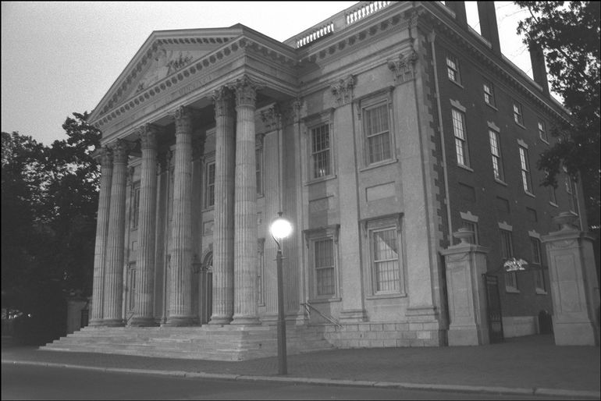
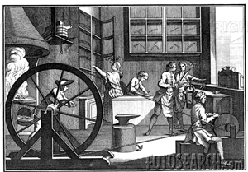
Bank of United States collects tariffs …
farmers
… then makes loans to …
businesses

Slide 10
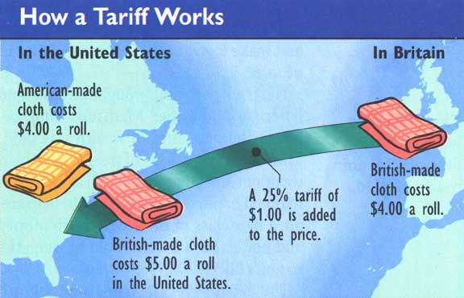
Tariff's
Tariff is a tax on imported goods. It serves two purposes:
1. raise money for the government.
2. encourage growth of American industry.

Slide 11
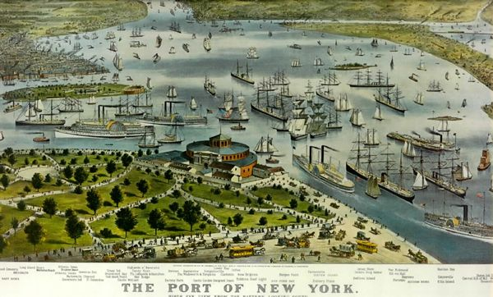
Tariff on imports

Slide 12
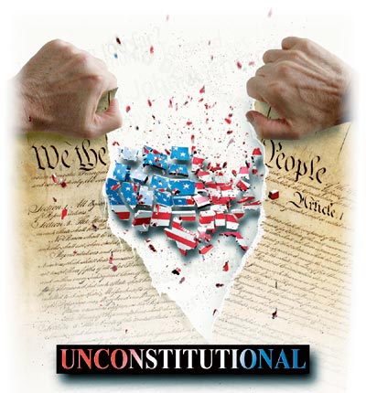
Bank Plan unconstitutional???

Slide 13
STRICT CONSTRUCTION
The government has only the
powers that the constitution
specifically gives it

Slide 14
Loose construction
The government can do
anything the constitution
does not say it cannot do

Slide 15
Elastic clause
A clause in the constitution
that permits congress to
pass laws that are
necessary for congress to
carry out its existing powers.

Slide 16
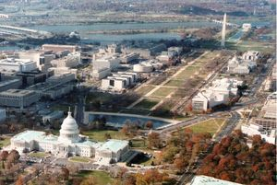
Bank Compromise
Anti-federalists get new capital in the south (Maryland) which will become Washington, D.C.
Federalists get the
Bank of the United States

Slide 17
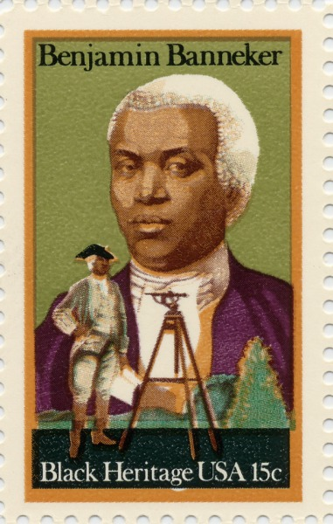
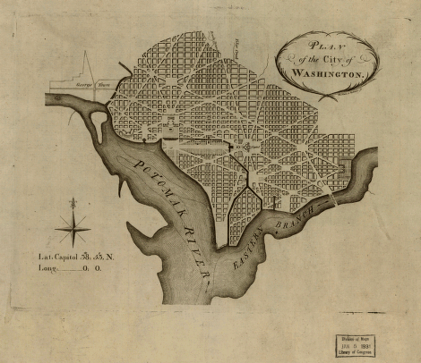
Architect of Washington, D.C.

Slide 18
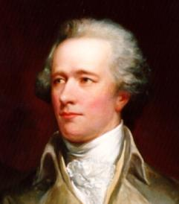
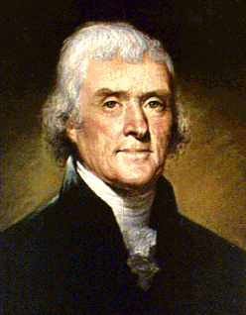
Objective: To analyze the differences between the first political parties.
Alexander Hamilton
Thomas Jefferson
Federalists
Democratic - Republicans

Slide 19
First Political Parties
Federalists
Democratic Republicans
led by Alexander Hamilton
led by Thomas Jefferson
strong central government led by industry and the wealthy
strong state governments led by the “common man”
emphasis on agriculture
“Cultivators of the earth are the most valuable citizens.” – Thomas Jefferson
emphasis on manufacturing, shipping, and trade
loose interpretation of the Constitution
strict interpretation of the Constitution
favored the national bank
opposed the national bank
favored protective tariffs
opposed protective tariffs
pro-British
pro-French

Slide 20
Hamilton and Jefferson: Differing Views
Alexander Hamilton
Thomas Jefferson
Favored trade, manufacturing and cities
Favored farmers and rural communities
Believed that the federal government should have more power than the states
Believed that states should have more power than the federal government (state’s rights)‏
Believed in a loose interpretation of the Constitution
Believed in a strict interpretation of the Constitution
was pro-British
was pro-French

Slide 21
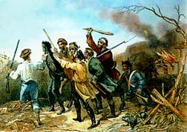
WHISKEY REBELLION
Farmer’s revolt in western Pennsylvania.
Refused to pay Hamilton’ s excise tax
Believed it was an unfair tax.
Were called the “Whiskey Rebels”

Slide 22
whiskeymap
Whiskey Rebellion
Whiskey Rebels refused to pay the excise tax that was passed by Congress and signed into law by President Washington….Believed this tax was unfair because it was taxing their income……

Slide 23
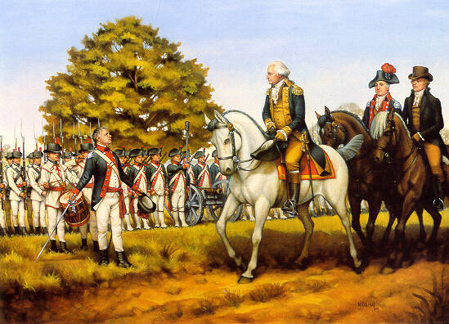
Whiskey
WHISKEY REBELLION
Issue at hand was testing the power of the new Constitution
Outcome:
Demonstrated to the people that this new constitution was powerful enough to put down domestic rebellions, “mobocracy”
Showed the power of the national government
President Washington reviews 13,000 troops of the Western Army assembled at Fort Cumberland, Maryland, to crush the Whiskey Rebellion.

Slide 24
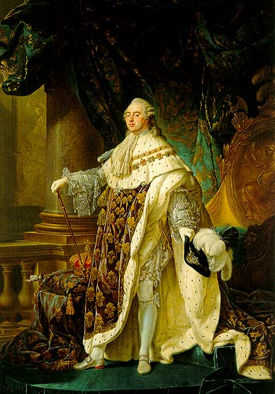
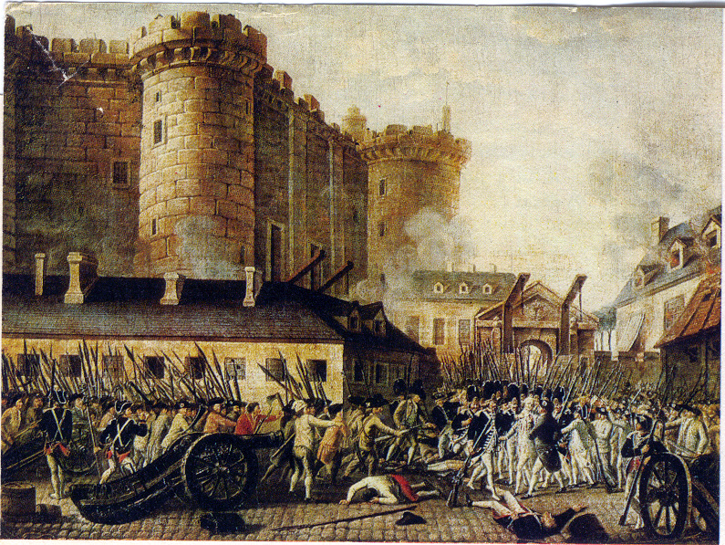
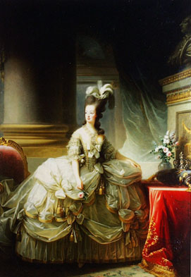
French Rev
FRENCH REVOLUTION
LIBERTY, EQUALITY AND FATERNITY
Began in 1790’s, unfair taxation and inequality---worldwide crisis
Overthrow King Louis 16th and Marie Antoniete
similar to King George
Americans believed we should help the French----similar to ours

Slide 25
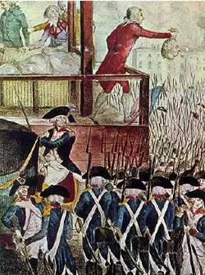
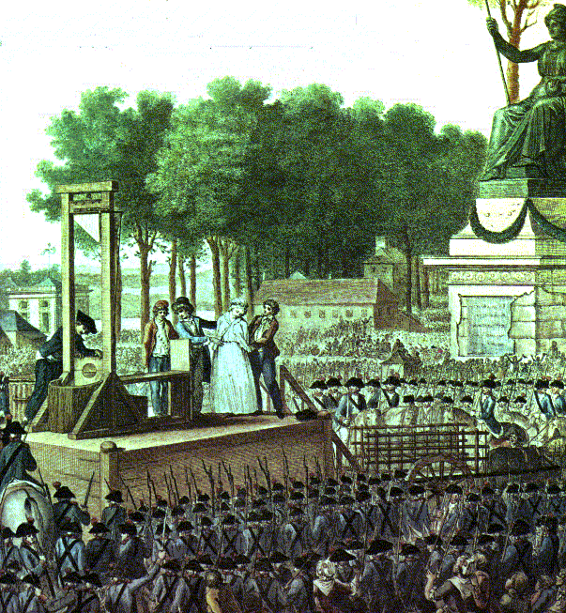
French Rev
FRENCH REVOLUTION
LIBERTY, EQUALITY AND FATERNITY
Executions of King Louis the 16th and Marie Antoniette in 1793.
Begins “Reign of Terror” during French Revolution where 40,000 opponents of the new govt. were beheaded.
France goes to war against European kings
France requested US ships to block West Indies from the British
President Washington declared Neutrality and ordered Americans to avoid this war

Slide 26
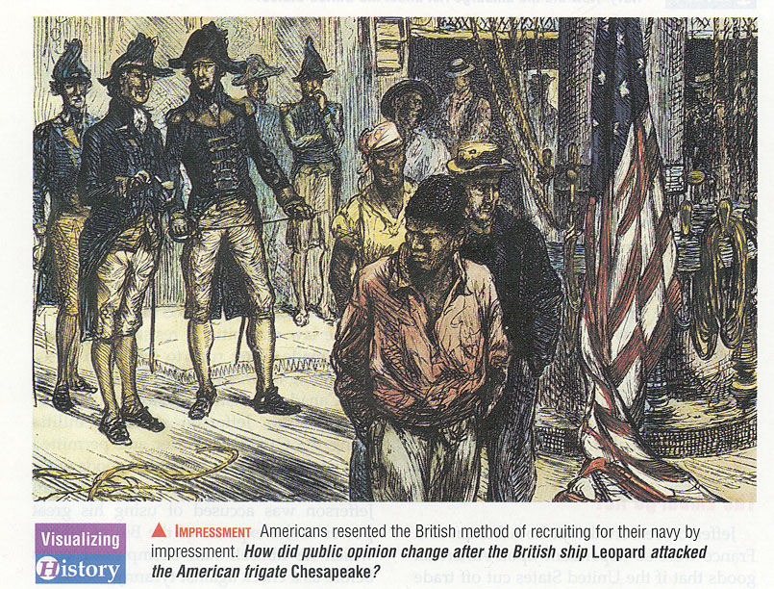
impressment
IMPRESSMENT
Impressment: an act of kidnapping a ship, its contents, men and forcing them into your navy----the British and French were doing this to us.

Slide 27
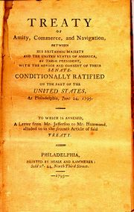
Treaty to secure borders between United States and British Canada

Slide 28
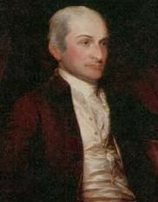
John Jay
Chief Justice of the Supreme Court
Was chosen by George Washington to negotiate a treaty with Britain

Slide 29
Jay’s Treaty
Britain had to..
U.S. had to..
Remove their soldiers located in the Northwest Territory
Stop supplying Native Americans with Weapons
Pay for all the damages that occurred in the impressments
Pay Britain for the debts they owed them leftover from the Revolutionary War

Slide 30
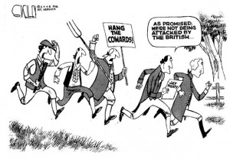
The Results of the Treaty
Many Americans were angry because they treaty did not stop British impressments on American sailors

Slide 31
Senate Passes the Treaty
The vote from the senate passed the treaty by a vote of 20 to 10
This was the minimum amount of votes to be passed

Slide 32
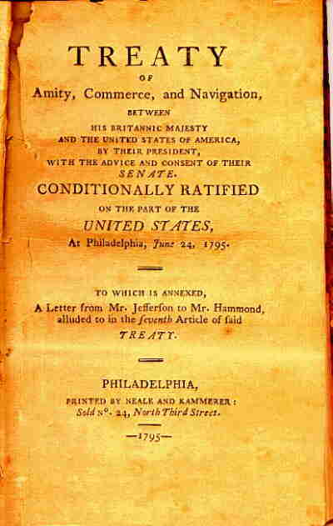
Overview
Although many people were disappointed in Jay’s Treaty, it prevented war from occurring with British.
It also kept Washington’s main goal of remaining neutral in foreign affairs.

Slide 33
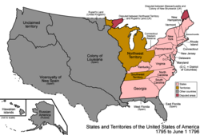
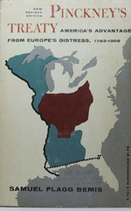
Pickney’s Treaty
Secures borders between Ohio Valley and Spanish territory in Florida and along the Mississippi

Slide 34
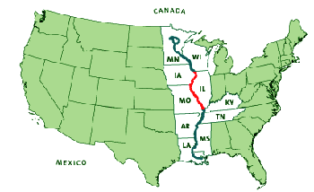
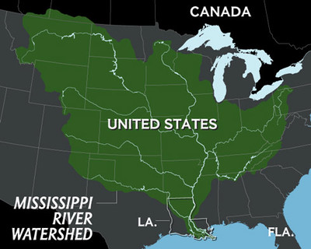
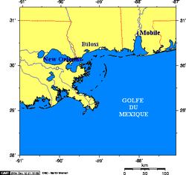
New Orleans at the mouth of the Mississippi was the most important city in the region because all goods from Ohio Valley had to be shipped down the Mississippi.

Slide 35
Washington retires!
Farewell address:
Avoid party politics
Stay neutral
Don’t make long term pacts
with foreign nations

