Slide 1
Nullification Crisis
States Rights Vs. Federal Goverment

Slide 2
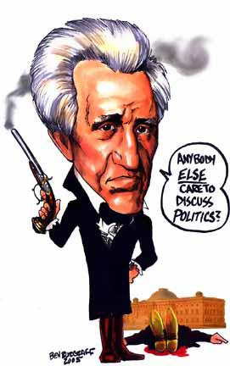
Nullification Crisis

Slide 3
Tariff of 1828
Tariff Act of1828 is passed under JQA, raising taxes on imported goods like cloth and glass.
The idea was to encourage the growth of manufacturing and industry. Higher tariffs meant higher prices for imported factory goods. American manufacturers could then out-sell foreign competitors.

Slide 4
Tariff of Abominations
Southern states thought it was unfair, because it only favored the north and called it the ‘Tariff of Abominations’. John C. Calhoun calls on Southern states to nullify the Tariff.
Tariffs raised prices Southerners paid for factory goods. High tariffs also discouraged trade among nations, and planters in the south were worried tariffs would hurt their cotton sales to Europe.
Remember, ‘nullify’ means to reject or make void.

Slide 5
Tariff Act of 1832
Jackson and congress agree to lower the tariff rates in the Tariff Act of 1832, but Southerners think it’s still too high.
Jackson was trying to appeal to the South because he sympathized with them. After all, he was a southern planter himself.
The lowered tariffs did not satisfy the most extreme supporters of states’ rights.

Slide 6
Nullification
John C. Calhoun leads South Carolina in nullification of the Tariffs’ of 1828 and 1832, meaning South Carolina rejects both federal laws. They also threaten to secede and build their own army if the national government tries to enforce the tariffs.
Secede means to withdraw from the Union
This is similar to the Kentucky and Virginia Resolutions, only with more threats

Slide 7
Jackson gets mad and calls on Congress to pass the Force Bill, which allows him to use the federal army to collect he tariffs.
Jackson famously said ‘If one drop of blood be shed there in defiance of the laws of the United States, I will hang the first man of them I can get my hands on from the first tree I can find!’

Slide 8
The Great Compromiser
Henry Clay steps forward with a compromise tariff in 1833. South Carolina backs down from its threats and everyone chills out… for now!
Between the Force Bill and the Compromise, South Carolina realizes it has firm opposition. They back down and the nullification crisis is over.
However, tensions between the North and the South will continue to grow.

Slide 9
Tariff of Abominations

Slide 10
Analyze this political cartoon…

Slide 11
Political Cartoon Explained….
John C. Calhoun is the figure at the top of the staircase. He believed states had the right to nullify federal laws.
The crown symbolizes his desire for power as he reaches for it, climbing stairs labeled ‘Nullification, S.C. Ordinance, Treason, Civil War, Deception, and Disunion’
Jackson is pulling on the coattails of a Calhoun supporter.
Jackson is trying to prevent Calhoun from trampling on the Constitution and destroying the union.

