Slide 1
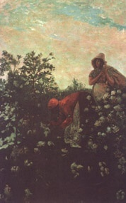
Reconstruction

Slide 2
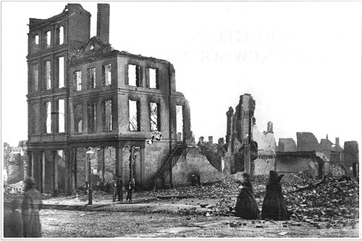
State of the South

Slide 3
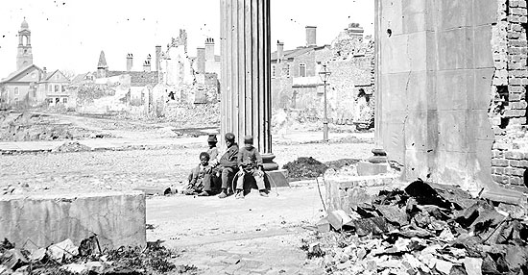

Slide 4
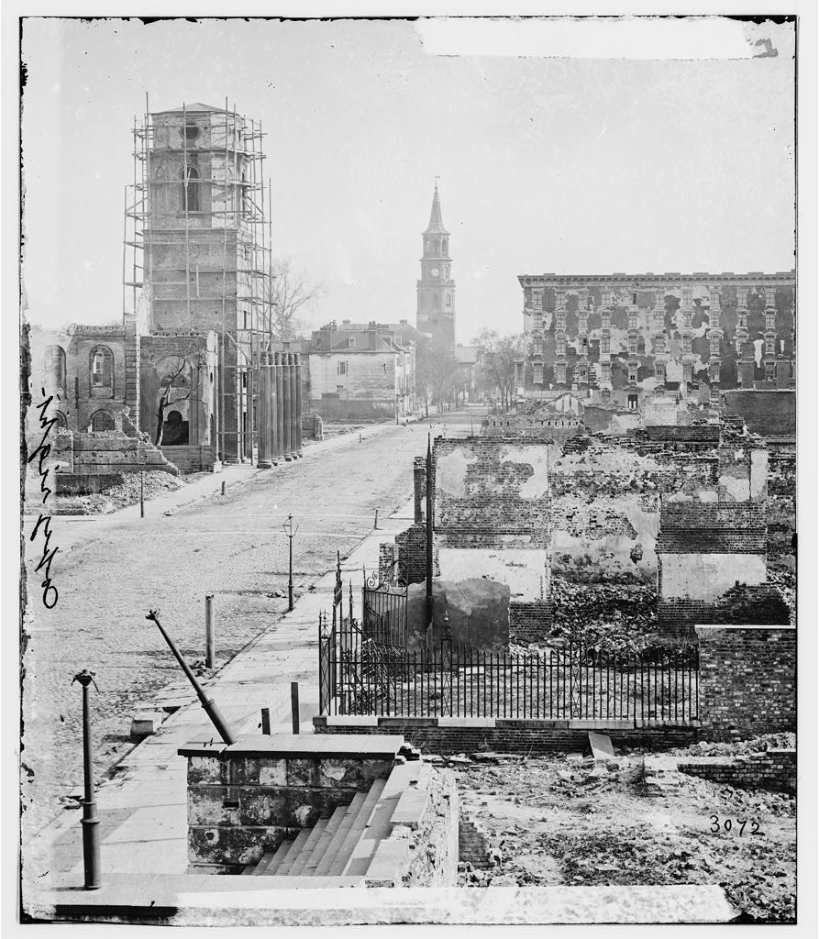

Slide 5
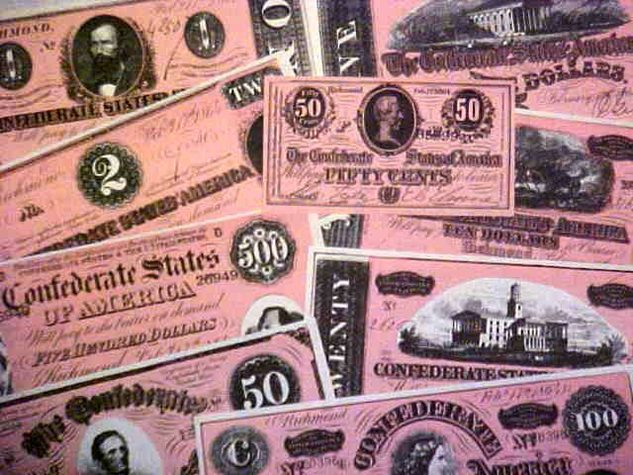

Slide 6
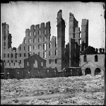
Questions of Reconstruction
How to rebuild the South after the Civil War?
How to readmit the Confederate states to the Union?
Are we forgetting anything?

Slide 7
Lincoln’s Ten Percent Plan
Offer amnesty (pardon) to those willing to take a loyalty oath to the United States.
10 percent of the population must take the oath = readmission as a state.

Slide 8
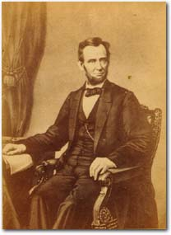
Wade-Davis Bill
Radical Republicans in Congress saw Lincoln’s plan as a threat to their authority and they wanted to punish the South.

Slide 9
Southern states had to pay Confederate debt.
  Required ex-Con. to take an ironclad oath of loyalty.
  Lincoln blocked the plan.

Slide 10
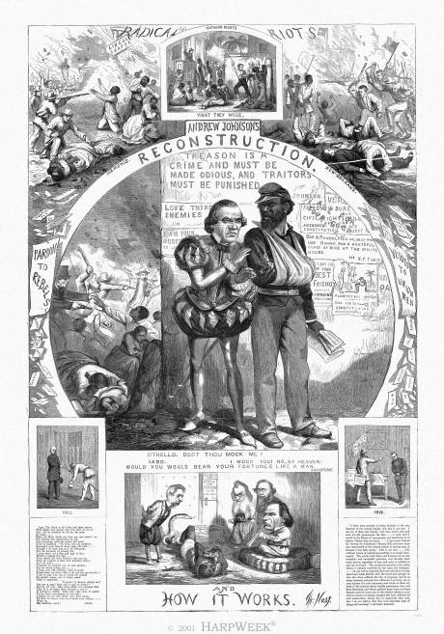
Johnson’s Reconstruction Plan
Pardon all southerners who take an oath of loyalty to the Union.
Former Confederate states could set up state governments.
Each state needed to revoke secession, ratify the 13th Amendment.

Slide 11
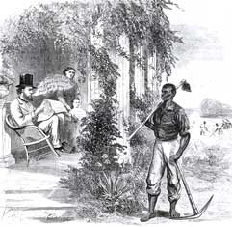
Black Codes
Southern laws which limited African American rights in the South.
Intended to keep African Americans in a condition of slavery.

Slide 12
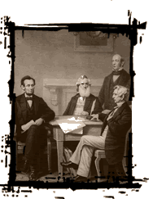
Radical Republicans
Opposed Johnson’s plan.
Wanted to punish the South and make permanent changes there.
Led by Thaddeus Stevens.

Slide 13
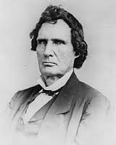
“The whole fabric of southern society must be changed…If the South is ever to be made a safe Republic let her hands be cultivated by the toil of the owners, or the free labor of intelligent citizens.”
-Thaddeus Stevens, The Era of Reconstruction

Slide 14
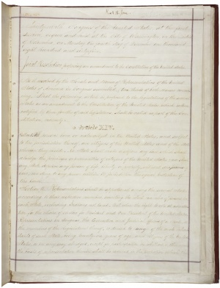
*Fourteenth Amendment
June 1866
Granted citizenship to all persons born or naturalized in the United States.

Slide 15
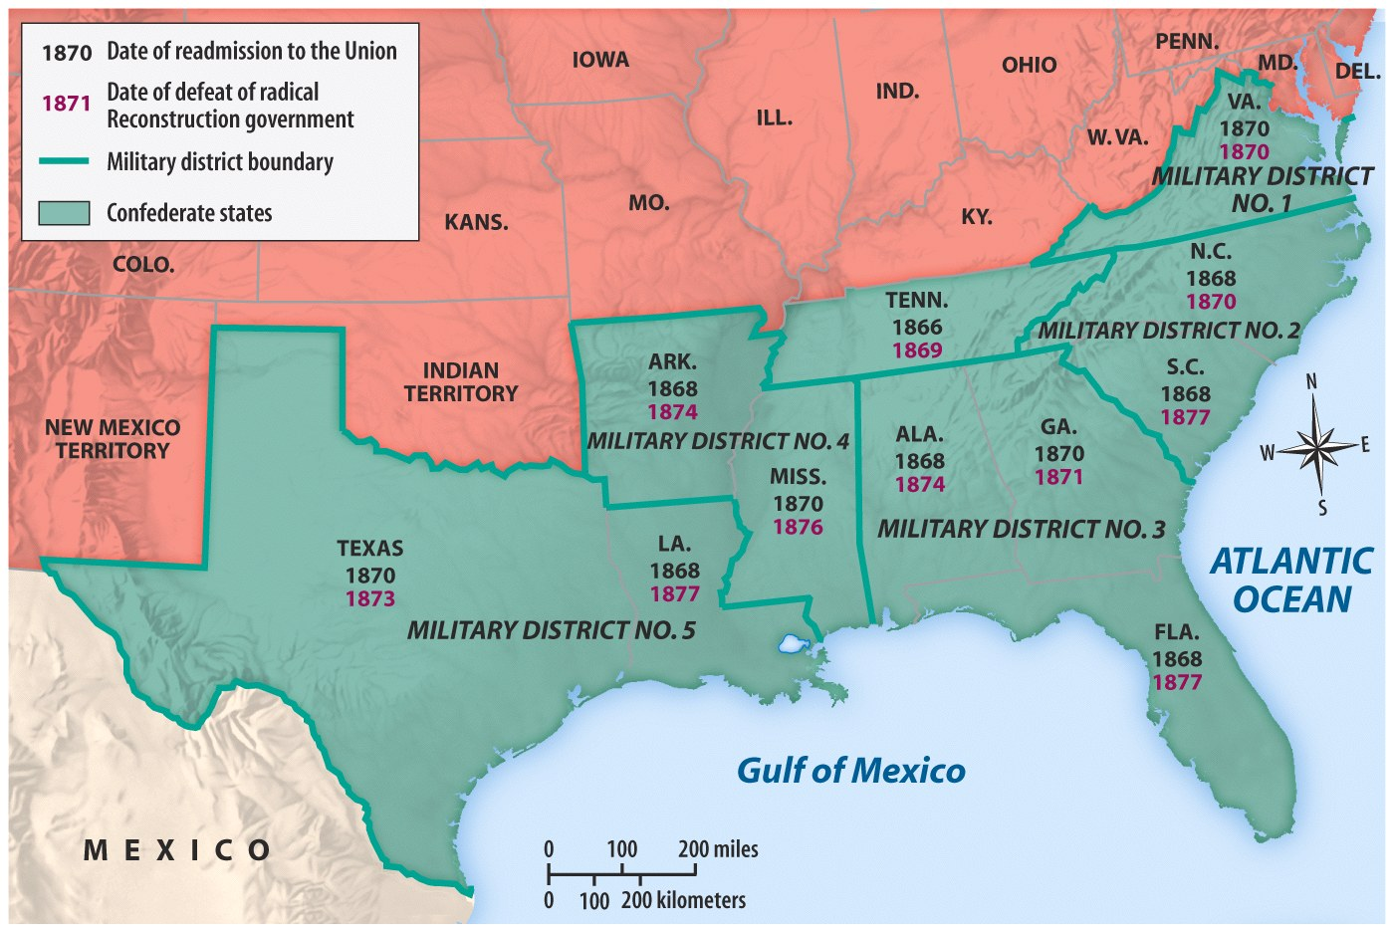
*Military Reconstruction Act
Passed by Congress.
Divided the South into five military districts controlled by Union Generals.

Slide 16
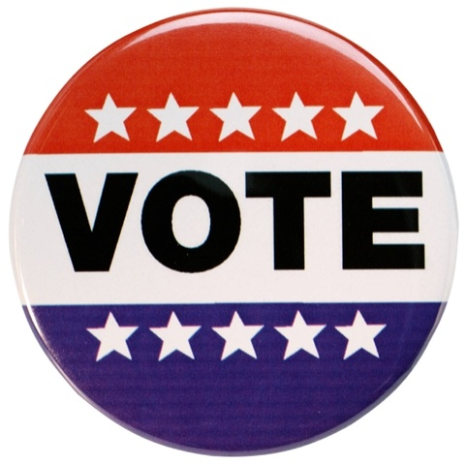
*Military Reconstruction Act
New state constitutions.
Right to vote for all males.
Must ratify the 14th Amendment.

Slide 17
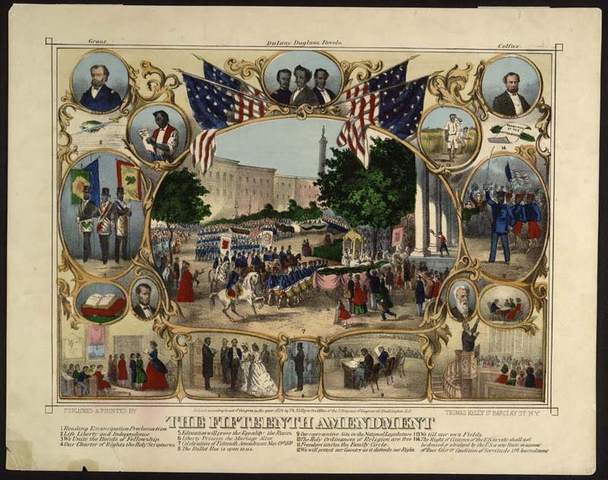
*Fifteenth Amendment
March 1870
Right to vote cannot be denied “on account of race, color, or previous condition of servitude.”

Slide 18
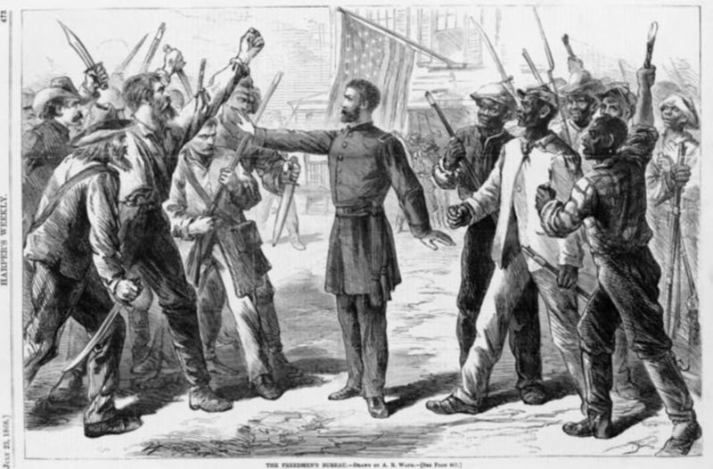
*Freedmen’s Bureau
Government group created to provide food, clothing, jobs, and education for the newly freed slaves.
Never properly funded

Slide 19
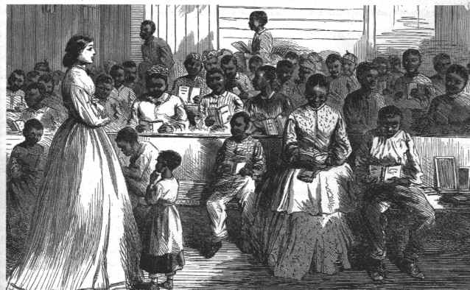
Freedmen’s Bureau

Slide 20
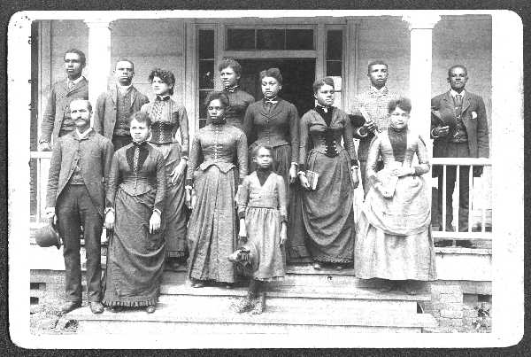
Freedmen’s Bureau

Slide 21
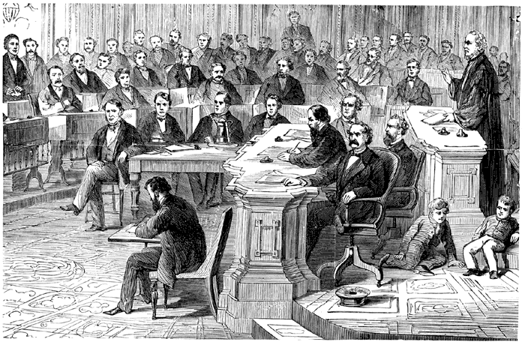
Impeachment of Johnson
Johnson vetoed every policy from the Radical Republican-led Congress.
Congress overrode his vetoes.

Slide 22
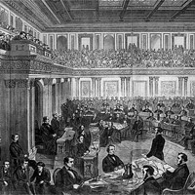
Impeachment of Johnson (1868)
House of Representatives voted for his impeachment.
Senate put Johnson on trial.
Final vote – one vote shy of removing him from office.

Slide 23
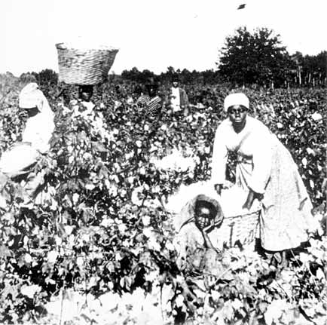
Sharecropping
New system for agriculture.
Tenant farmers paid rent with a share of their crops.

Slide 24
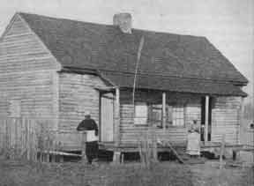
Sharecropping
Sharecroppers became trapped because farmers could not pay their debts.

Slide 25
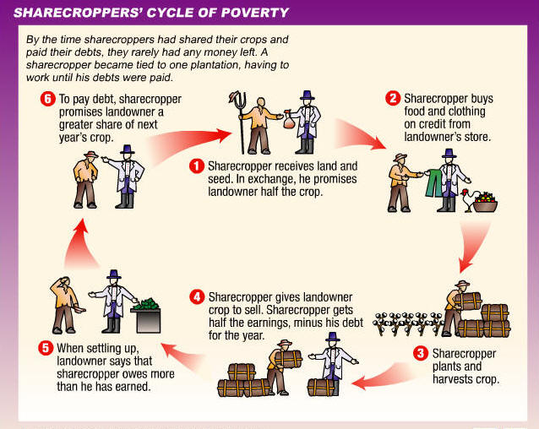

Slide 26
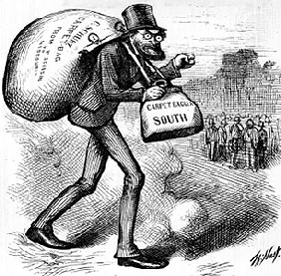
Carpetbaggers
Northerners who came to the South during Reconstruction, seeking money and political power.

Slide 27
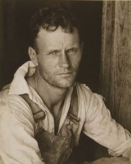
Scalawags
White southerners who supported Reconstruction.

Slide 28
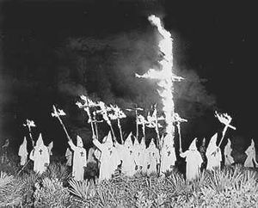
Ku Klux Klan
Started in 1866 by Nathaniel Bedford Forrest.
Americas first terrorist group.
Mostly former Confederate soldiers.

Slide 29
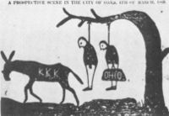
Goals of the KKK
Use terror to drive out carpetbaggers and regain political control in the South for the Democrats.

Slide 30
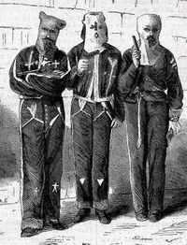
Tactics of the KKK
Broke up Republican meetings.
Harassed Freedmen’s Bureau workers.
Burned homes, churches, schools.
Kept Republicans (white and black) from voting.

Slide 31
Letter to the U.S. Senate
“We believe you are not familiar with the description of the Ku Klux Klan’s riding nightly over the country, going from county to county, and in the county towns spreading terror wherever they go by robbing, whipping, ravishing, and killing our people without provocation . . . We pray you will take some steps to remedy these evils.”

Slide 32
Election of 1876
One of the most disputed elections in American History.
Tilden had 184 electoral votes to Hayes 165 with 20 votes uncounted.
The 20 disputed votes were ultimately awarded to Hayes giving him the victory.

Slide 33
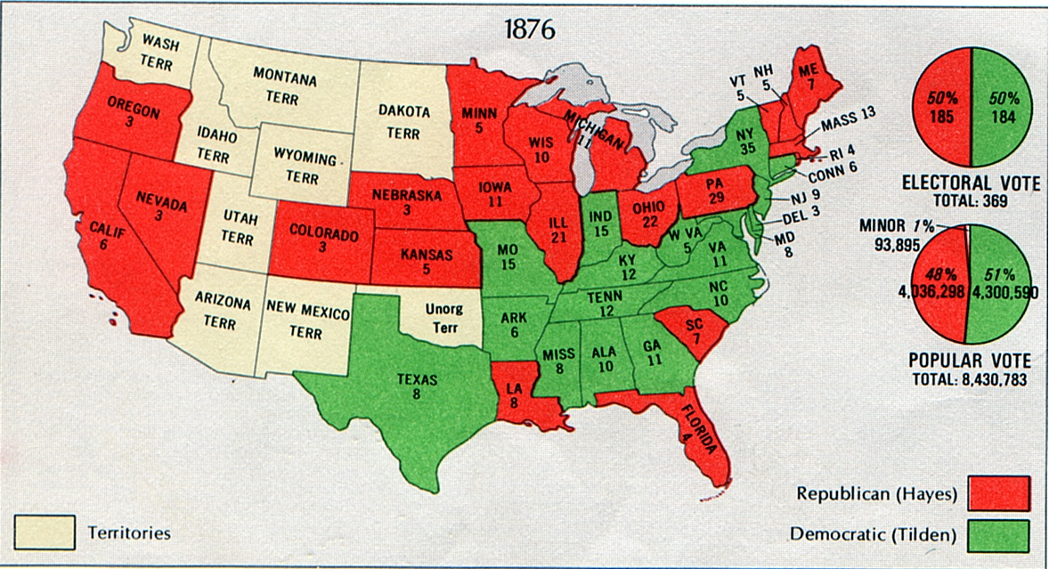

Slide 34
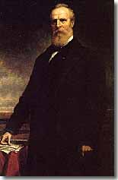
End of Reconstruction
April 1877
Hayes pulled federal troops out of the South.
Southern Democrats took control of all state legislatures.

