Slide 1
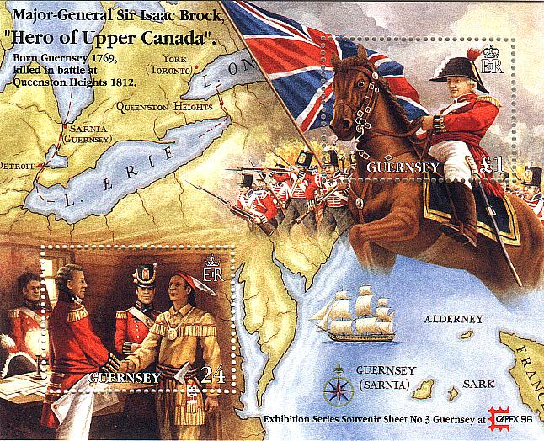
WAR OF 1812

Slide 2
Causes of the War of 1812
Impressment of US sailors.
Interference with American Shipping. (British Blockade of American Ships)
British support of Native American resistance. (Supplied them with weapons).

Slide 3
Warhawks
Tecumseh’s welcome in Canada outraged Americans.
Leaders in America such as Henry Clay and John Calhoun called for war against Britain.

Slide 4
Phases of the War
1st phase: 1812-1814
Britain was focused on their war with France (Napoleonic Wars).
Britain sent more blockades
2nd phase: 1814
Britain concentrated on the war with America.

Slide 5
The War Begins
Britain did not want a war with the US
To avoid war, Britain cancelled the blockade of American ships.
The word of the cancellation did not reach America until after we declared war.

Slide 6
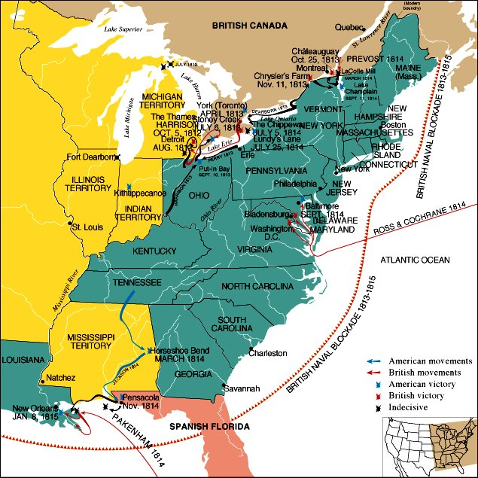
British Blockade

Slide 7
The First Phase of the War.
Conflict on Lake Erie
Navy was attacked by British
Oliver Hazard Perry
Defended fleet
“Don’t give up the ship”

Slide 8
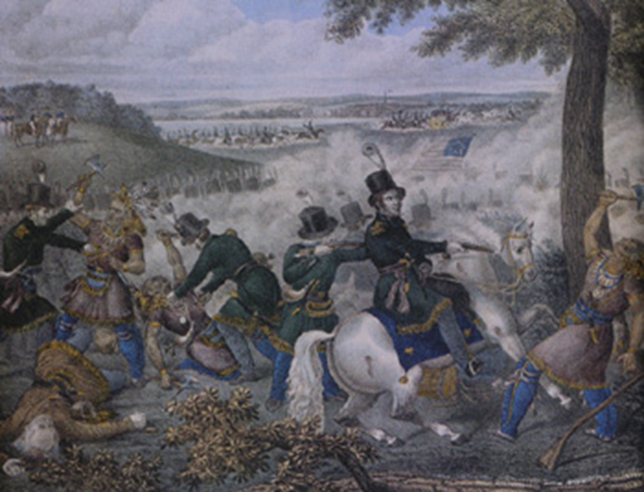
Battle of Thames
-British retreated into Canada
-General Harrison pursued and defeated the British navy.
-Victory put an end to the British threat in the Northwest.
-Tecumseh was killed fighting for the British.

Slide 9
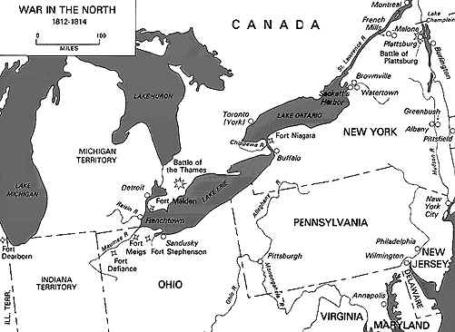

Slide 10
The Second Phase of the War
The Napoleonic Wars were over.
British forces burned the Capitol building and the President’s mansion.
Dolley Madison saved valuables like Pres. Washington painting and Dec. of Ind.

Slide 11
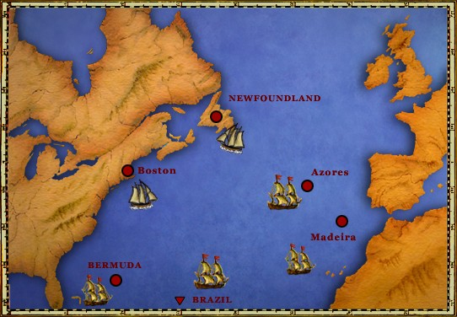
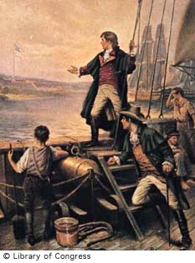
*5
FRANCIS SCOTT KEY wrote the National Anthem as he watched the attack on Fort McHenry.

Slide 12
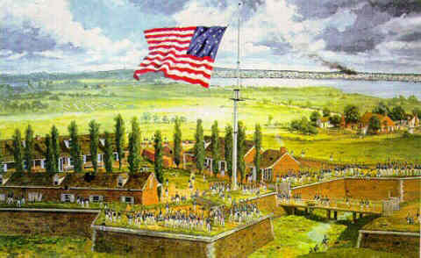
AMERICAN FLAG AT FORT Mc HENRY

Slide 13
Other Battles
Battle of Lake Champlain (US)- Cut off New England.
Battle of New Orleans-Block off mouth of Mississippi River.
Ships carrying 7,500 British approached New Orleans.
71 casualties for US, 2,000 for British.
Jackson was a hero and became a household name.

Slide 14
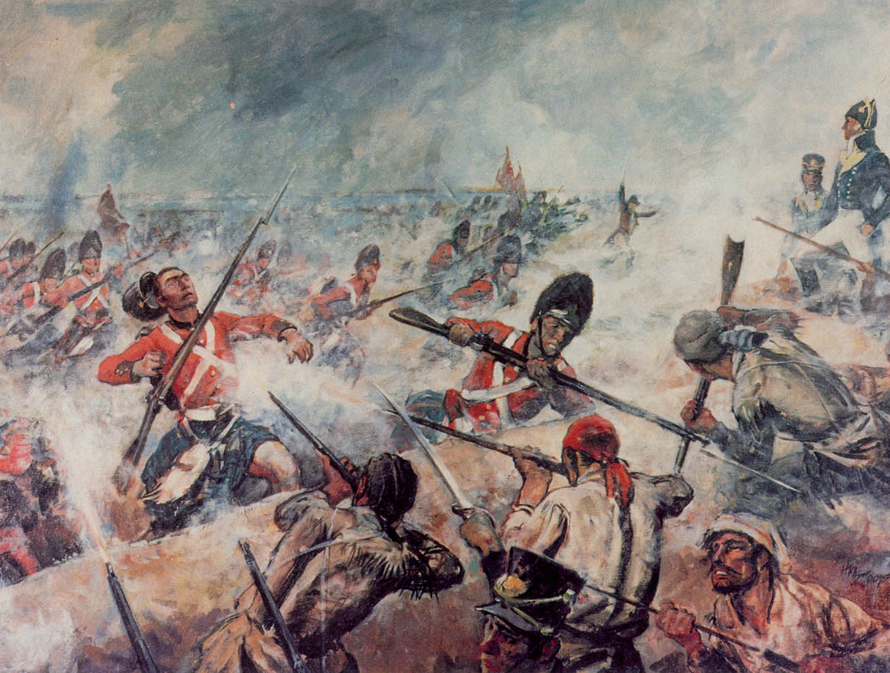
BATTLE OF NEW ORLEANS

Slide 15
*7
TREATY OF GHENT ended the War of 1812.
Basically there was no clear winner and many trade disputes were still unsettled.

Slide 16
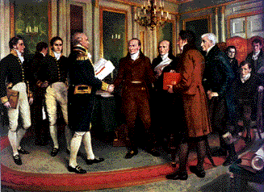
SIGNING THE TREATY OF GHENT

Slide 17
Effects of the War of 1812.
Increased American patriotism.
Change in American Foreign Policy. (We stood up to the bully).
Weakened of Native American resistance.
American Trade and manufacturing expanded.

