Slide 1
Battle of the Bank

Slide 2
Battle of the Bank
Watch the following video…
http://www.pbs.org/kcet/andrewjackson/edu/video.html

Slide 3
2nd National Bank
The Second Bank of the United States was a national bank overseen by the federal government to regulate state banks.
Established in 1816 and given a 20-year charter
Opponents (including Jackson) thought that the Constitution did not give Congress the authority to create the bank.
Opponents recognized that state banks were more inclined to make loans to poorer farmers in the South and West—the very people who supported Jackson.
By contrast, they viewed the bank as an institution devoted to the interests of wealthy northern corporations.

Slide 4
Death of the Bank…
In 1832, an election year, Jackson vetoed a bill to extend the bank’s charter.
When Henry Clay challenged Jackson for the presidency, the controversy over the bank became a major campaign issue.
Jackson won re-election, defeating Clay in a landslide.
After his re-election, Jackson ordered the money taken out of the bank and deposited in select state banks.
In 1836 the Second Bank of the United States was reduced to just another state bank.

Slide 5
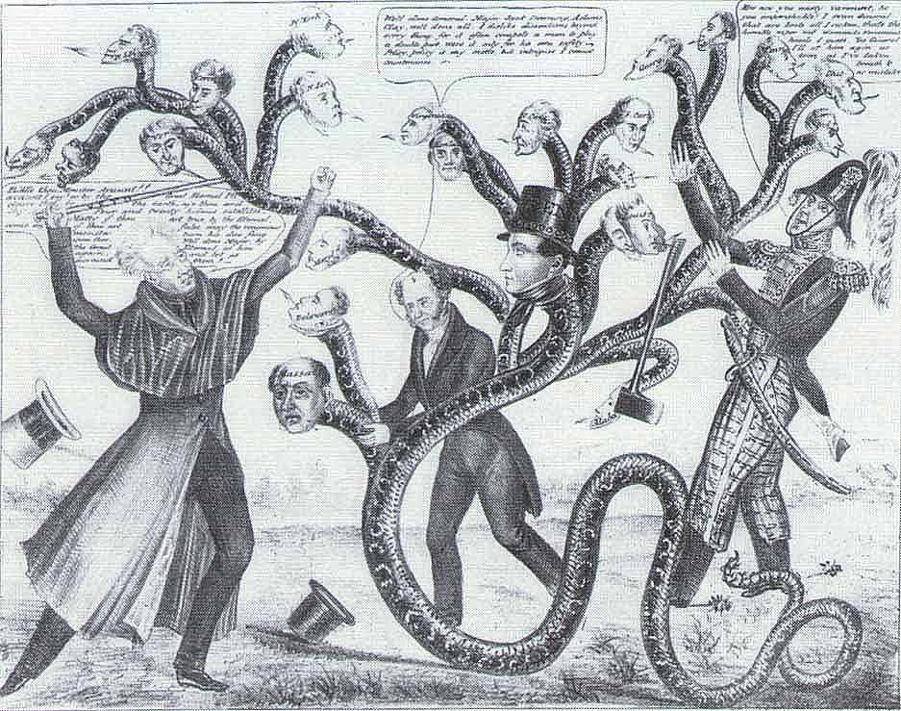
Political Cartoon
“… some of the powers and privileges possessed by the existing bank are unauthorized (not given permission) by the Constitution and dangerous to the liberties (freedoms) of the people…” - President Andrew Jackson, Veto of the Bank Charter, 1830
“… It appears that more than a fourth part is owned by foreigners and the residue (rest) is held by a few hundred of our own citizens, chiefly (mainly) the richest class.” - President Andrew Jackson, Veto of the Bank Charter, 1830
“… It is easy to conceive (see) that great evils to our country…might flow from such power in the hands of a few men irresponsible (not held responsible) to the people.” - Andrew Jackson’s Bank Veto Message to Congress 1832

Slide 6
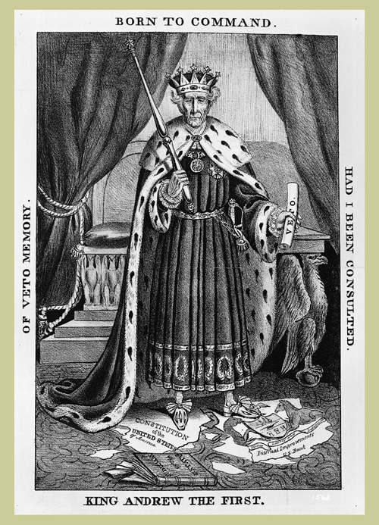
Political Cartoon
“…since the adoption of the Constitution, a bank has existed under the authority of the federal government for thirty-three out of forty years; during which time public and private credit have been maintained…fully equal to what has existed in any nation in the world…” – G. McDuffie, Chairman of the House Ways & Means Committee, 1830
“… It manifestly seeks to inflame (stir up) the poor against the rich. It attacks whole classes of the people for the purposes of turning against them the other classes.” –Daniel Webster’s Reply to Jackson’s Bank Veto Message, 1832
“…Its effects will be felt in the price of lands, in the price of crops, in the products of labor, in the repression (holding back) of enterprise, and in embarrassment to every kind of business and occupation…” - Daniel Webster, Speech to Senate, 1832

Slide 7
After the Bank is dead and buried…
A year after Jackson left office, the country experienced a financial crisis that many people directly attribute to the death of the bank.
Even things done with the best intentions can have negative consequences.

