Slide 1
Posting To Your Civil War Blog

Slide 2
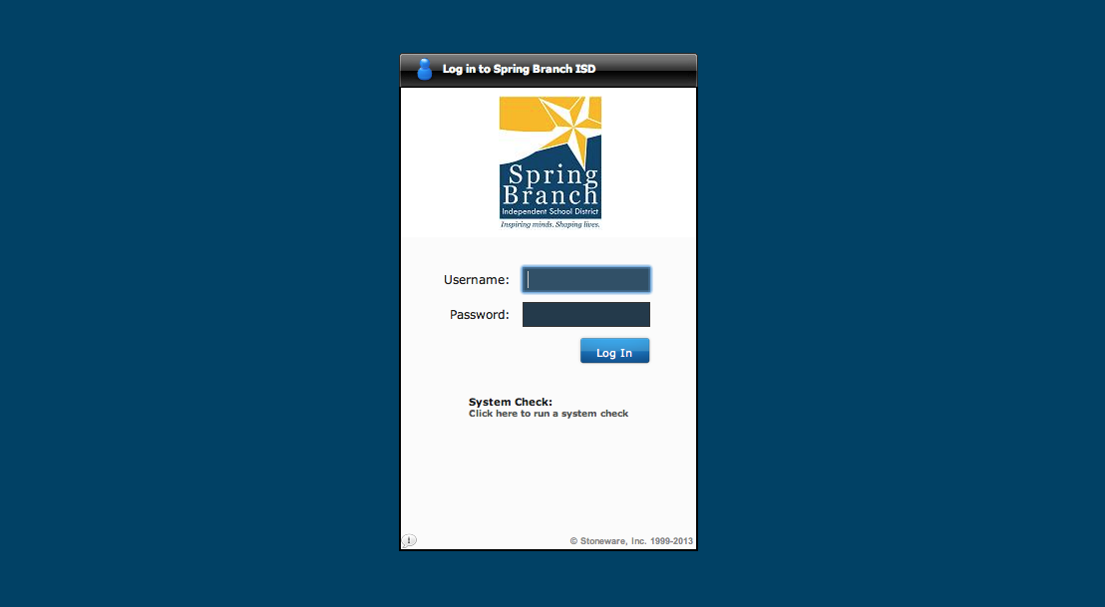
First, log into your SB Portal at www.sbportal.springbranchisd.com

Slide 3
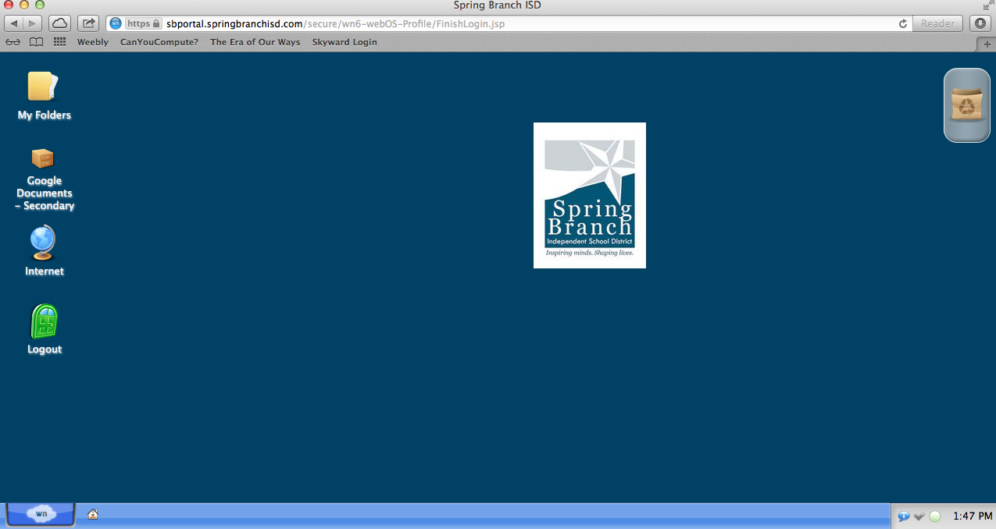
Once you are in your dashboard, go to your Google Documents

Slide 4
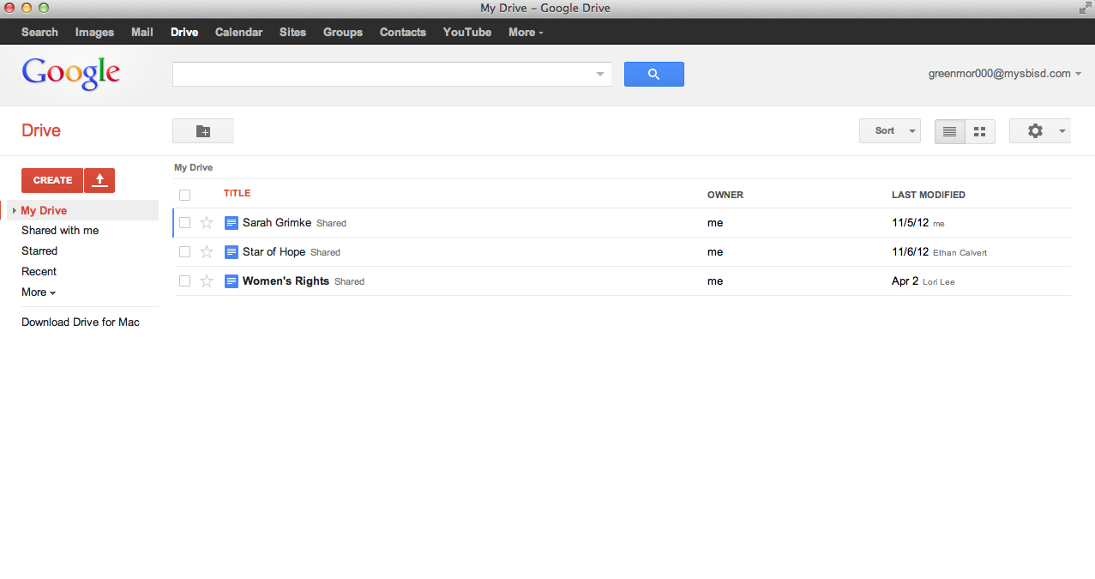
This will bring up your Google Drive.

Slide 5
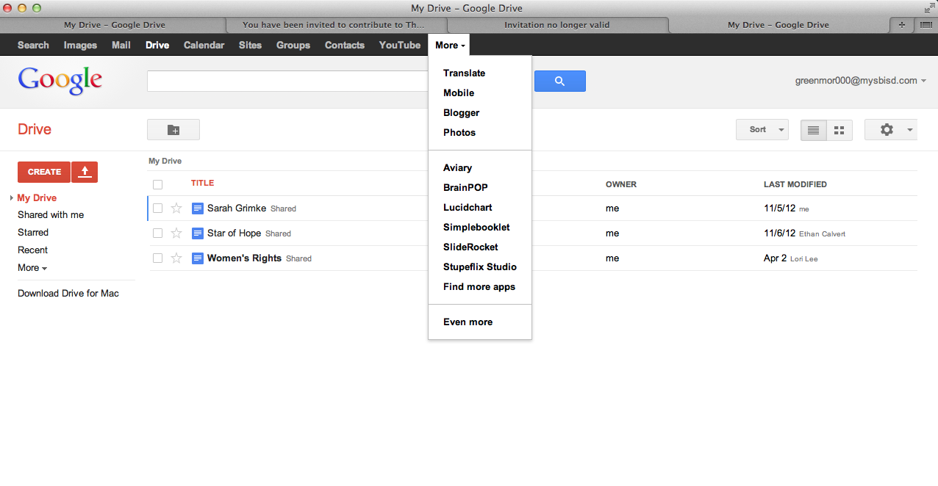
From your Google Drive, go to the drop down menu and select ‘Blogger.’

Slide 6
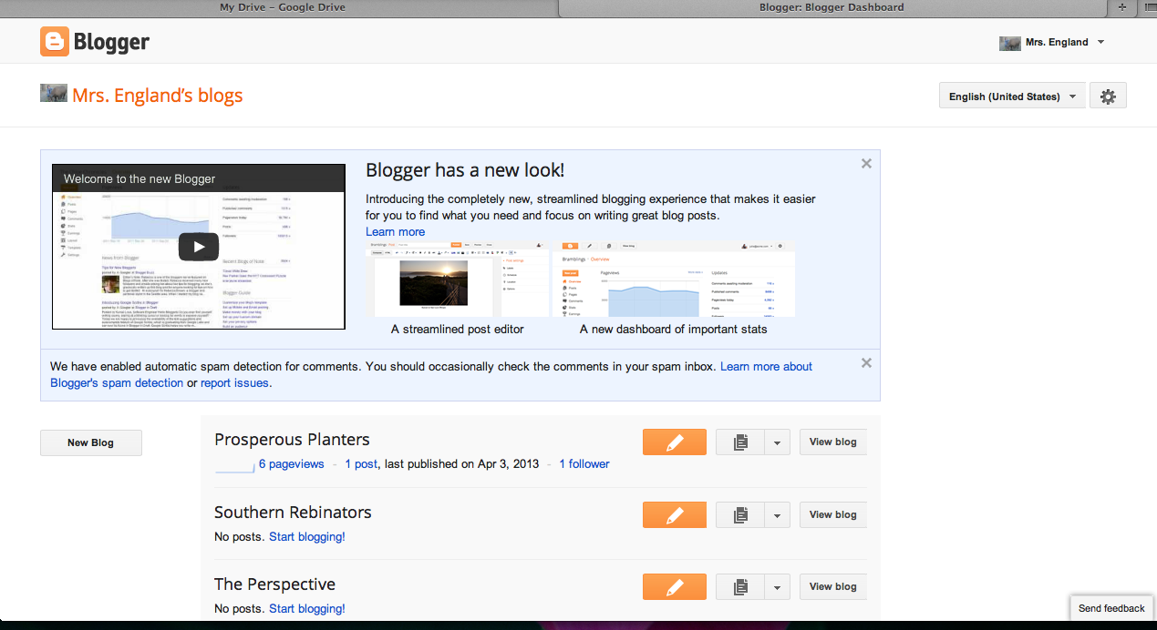
This will bring up your Blogger Dashboard. From there, you can create a new post using the orange pencil icon.
Choose the orange icon next to your Regiment Blog

Slide 7
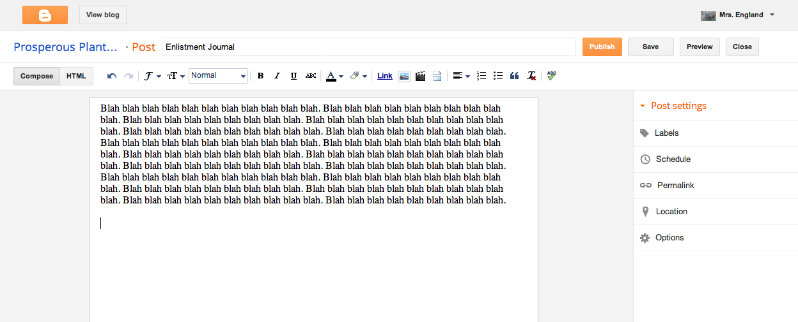
This will bring up your Post Editor page.

Slide 8
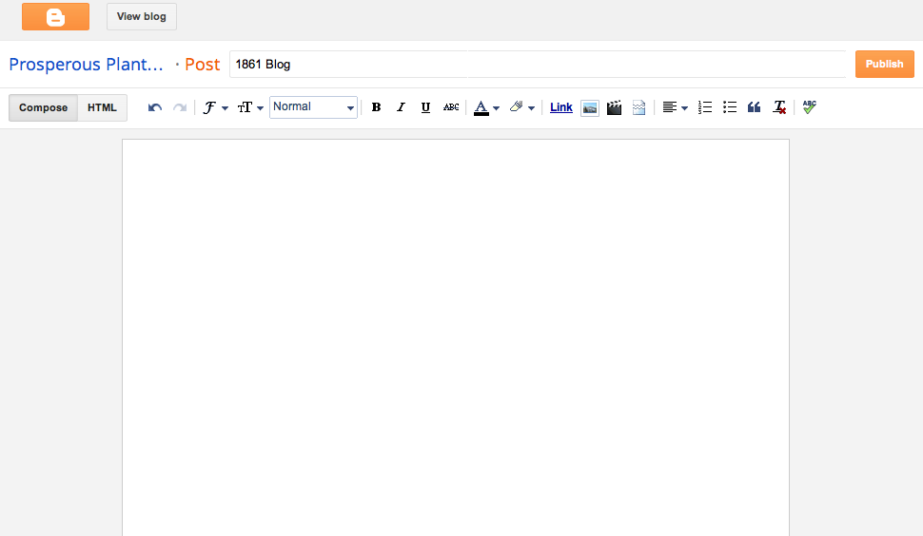
Give your post an appropriate title that matches the blog assignment. For example, ‘1861 Blog Post.’

Slide 9
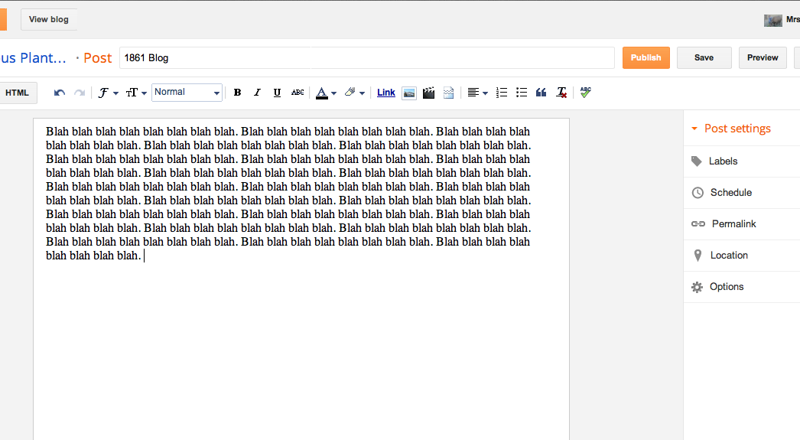
Write your blog post in the space provided.

Slide 10
After typing, check your grammar, punctuation, and spelling.
Spell Check!

Slide 11
Add any additional components to your blog.
Images & Graphics
Add links
Change Fonts
Add videos
Bullet Points & Lists

Slide 12
To add a photo or graphic.
You can add an image from your computer or the Web to your blog. Click the image icon in the Post Editor toolbar. A window appears prompting you to browse for an image file on your computer, or enter the URL (address) of an image on the Web.
Once you've selected your image, you can then choose a layout to determine how your image will appear in your post:
The 'Left', 'Center', and 'Right' options allow you to customize the way your blog text will flow around your image.
The 'Image size' options will determine how large the image will appear within your post.
Click UPLOAD IMAGES to add your image, and then click DONE when the notification window appears telling you that 'Your image has been added.' Blogger will then return you to the post editor, where you'll see your image ready to be published to your blog.

Slide 13
To add your video…
To add a video to your blog post, click the film strip icon in the Post Editor toolbar above where you compose your blog text. A window appears prompting you to 'Add a video to your blog post.’
Click Browse to select the video file from your computer that you'd like to upload. Note that Blogger accepts AVI, MPEG, QuickTime, Real and Windows Media files and that your video must be less than 100MB in size.
Before uploading your video, add a title in the 'Video Title' box and agree to the Terms and Conditions (you'll only have to do this the first time that you upload a video with Blogger). Then click UPLOAD VIDEO.
While your video uploads, you'll see a placeholder in the post editor showing where your video will appear. You'll also see a status message below the post editor letting you know that your upload is in progress. Depending on the size of your video, this usually takes about five minutes. When it is complete, your video will appear in the post editor.

Slide 14
Preview your post and make any necessary changes.

Slide 15
After you have previewed and double checked your post, you may publish it.

Slide 16
What if I’m doing a video?
Give your blog post an appropriate title.
Write a brief description (1-2 sentences) about your video.
Upload your video using the provided directions.

