Slide 1
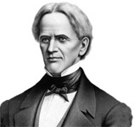
Horace Mann & Education Reform

Slide 2
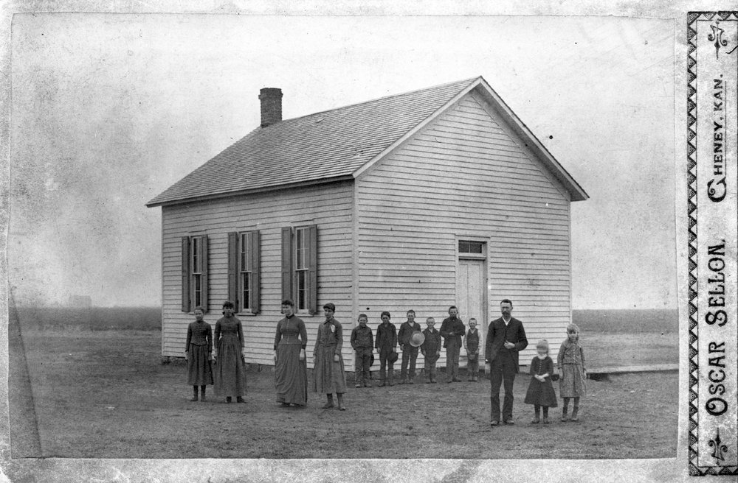

Slide 3
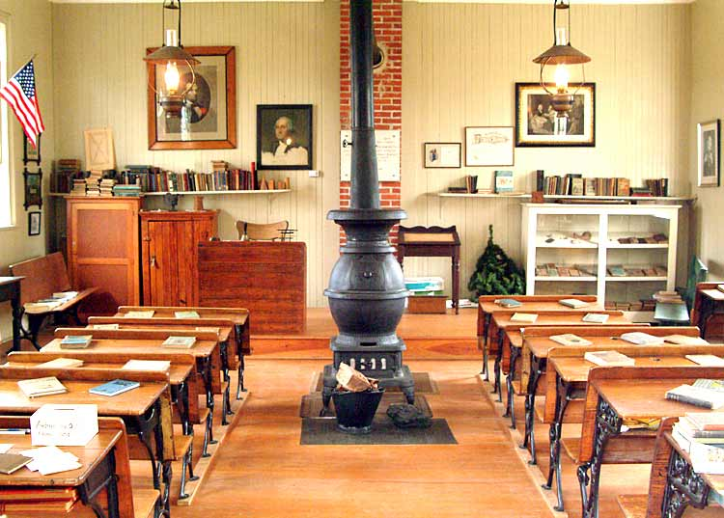

Slide 4
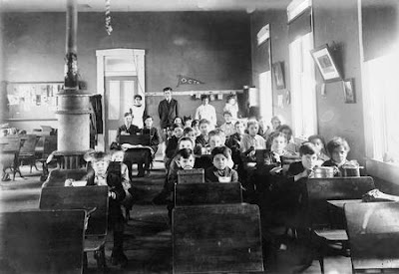

Slide 5
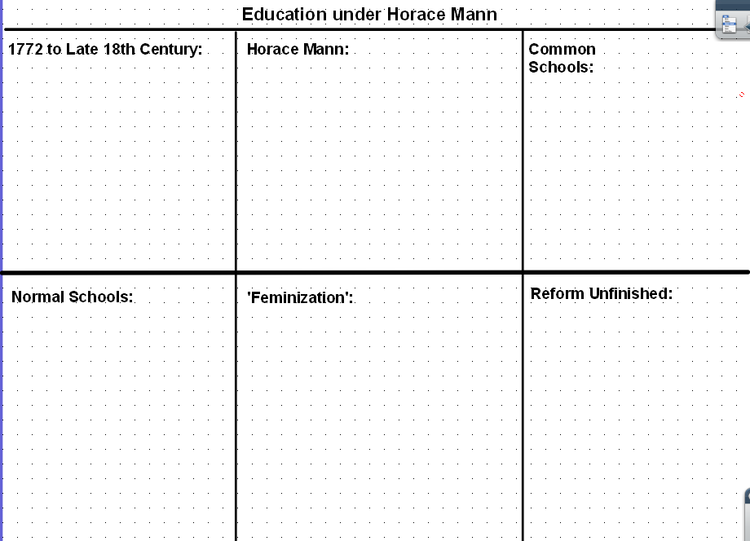

Slide 6
1772-Late 18th Century
School teachers were common men, like innkeepers, farmers, and surveyors with no real training.
Schools were one room with 60 or more students of all different ages.
Students attended only a few months around farming and work schedules.
Puritans established the first public schools funded by taxes.

Slide 7
Horace Mann
Worked on a farm as a child and had a poor education.
Became a Secretary of the Mass. Board of Education.
Started the Common School Movement to educate all.
Developed Normal Schools (teachers training schools) to professionalize teaching.
Argued that women would be a good source of teaching.

Slide 8
Commons Schools
First public schools
Taught basic literacy and arithmetic in addition to democratic citizenship.
Funded by taxes and fees.
Religion and social class did not matter, allowing education for all.

Slide 9
Normal Schools
Schools that trained teachers to teach and help provide a better education.
Helped ‘normalize’ or standardize teaching profession.
At the turn of the 20th century, normal schools were replaced by universities and colleges.

Slide 10
Feminization of Education
Women taught children in the home, so they were thought to be a natural fit.
Women could be paid 1/3 the salary of men to teach.
Women were a ready labor force that could be used to meet a growing need for teachers.

Slide 11
Unfinished Reform
African Americans were not allowed to go to school. It was illegal to teach slaves to read and write in the south.
Universities and colleges generally did not accept women.
Mann saw that women and minorities were at a disadvantage in education and opened universities to educate them.

Slide 12
Horace Mann Raft Writing Assignment
Your assignment: Write a thank you letter to Horace Mann for his contributions to education. You must use the words secular, reform, normal schools, and common schools.
Role- A proud CSA student who loves education.
Audience- Horace “Father of Education” Mann.
Format- A letter, that is at least a half page with correct grammar and spelling.
Topic- Horace Mann’s contributions to education reform. Include reason why you’re thankful for your education.

