Slide 1
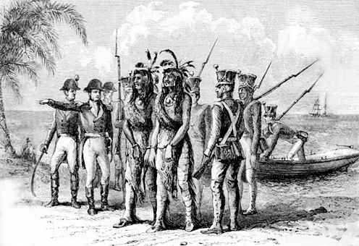
Florida and the Seminole Wars

Slide 2
Florida Territory
When our country purchased Louisiana, neither the French nor the U.S. were exactly sure what the boundaries were. At the time, Spain owned a narrow strip of land along the Gulf of Mexico (called West Florida), as well as the area we now call Florida (East Florida). Spain claimed that West Florida extended as far west as New Orleans. T.J. & the U.S. believed that the Louisiana Purchase included a considerable amount of land east of the Mississippi.

Slide 3
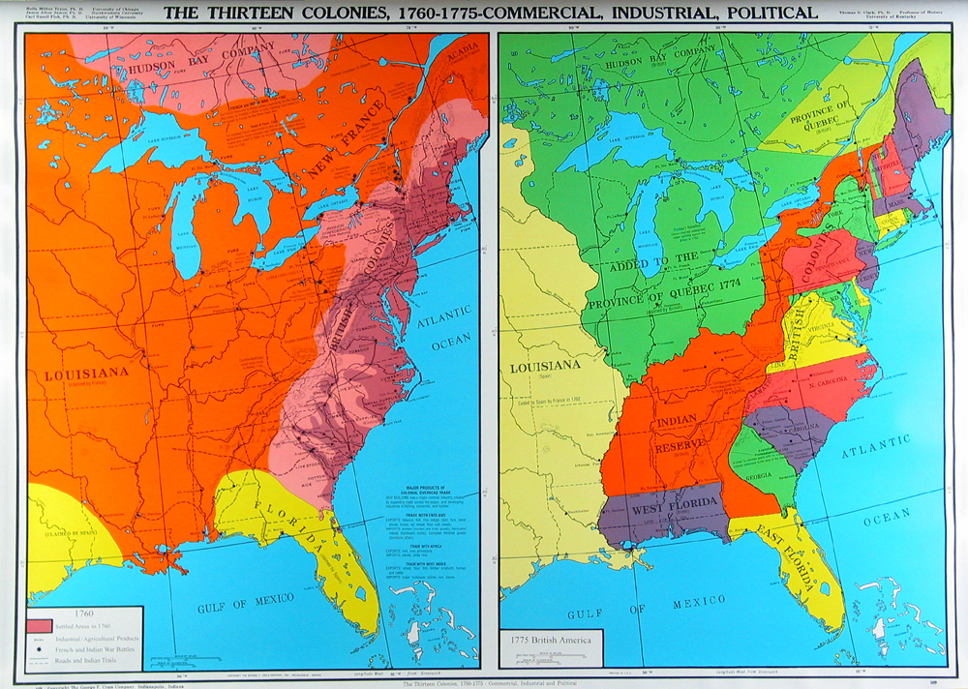
Geography Plays a Part

Slide 4
The U.S. expands into West Florida
The dispute went on for years. Finally, when Louisiana became a state in 1812, our government simply added to it all the territory east of the Mississippi which is now included in the present state of Louisiana. Spain was too weak to try and defend her claim.

Slide 5
Conflict Begins
In the meantime, East Florida had become a trouble spot. Runaway slaves from Georgia had been going there, safe from American authorities. Also, the Seminoles often raided frontier settlements just north of the Spanish border. Although Spain had agreed to keep the Indians in check, she did not have enough troops in Florida to do so.

Slide 6
The First Seminole War (1817-1818)
The first of 3 conflicts with the Seminole began when U.S. troops, in pursuit of runaway slaves, destroyed an old British fort that had become known as Negro Fort. This set off a series of raids and counter-raids. Finally, President Monroe ordered General Andrew Jackson to halt the Indian raids.

Slide 7
The First Seminole War
Jackson obeyed his orders too well. He marched his men into Florida in pursuit of the Seminole, although he had no right to invade Spanish territory. The army destroyed villages and captured two Spanish forts.

Slide 8
The First Seminole War
Although the American people applauded Jackson, he had created a bit of an embarrassing situation for Monroe, who had no desire to make an enemy of Spain. The two forts were returned to Spain and the American forces were withdrawn.

Slide 9
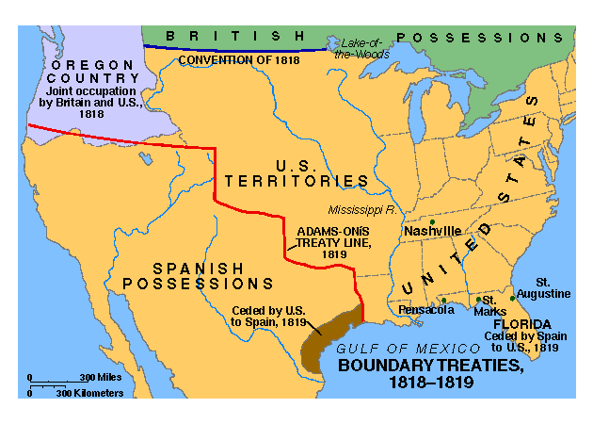
U.S. Acquires Florida
Jackson’s invasion of Florida made it clear that Spain could no longer keep their territory. Spain negotiated a treaty with the U.S. in 1819 known as the Adams-Onis Treaty. This treaty gave Florida to the U.S. in exchange for the U.S. forgiving $5 million in debt.

Slide 10
Second Seminole War
The Second Seminole War, which lasted from 1835 to 1842, was costly for both the United States and the Seminole. The conflict began after the passage of the Indian Removal Act in 1830. By 1834, 3,824 Indians had made the move. The largest faction of Seminole, led by their chief Osceola (1804?–1838), refused to go. Osceola vowed to fight "till the last drop of Seminole blood has moistened the dust of his hunting ground."

Slide 11
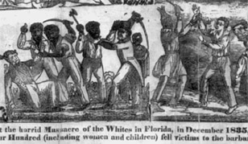
Second Seminole War
On December 28, 1835 Osceola murdered Indian agent Wiley Thompson. The same day, Major Francis Dade and his U.S. soldiers were ambushed by 300 Seminole warriors near Fort King (Ocala). These incidents began the Second Seminole War. The natives retreated into the Everglades, began guerilla tactics against U.S. forces and fought desperately for more than seven years.

Slide 12
Second Seminole War
By 1837, the Seminole apparently had managed to force a truce. During negotiations, however, Oceola was arrested under a false flag of truce and confined first at Saint Augustine, then Fort Moultrie at Charleston, South Carolina where he died on January 30, 1838. His followers fought on. By 1842, they were nearly exterminated. Some 4,420 Seminoles surrendered and were deported to Oklahoma.

Slide 13
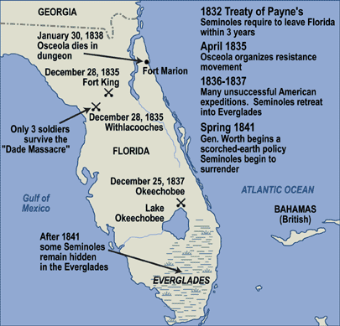

Slide 14
Florida Becomes the 27th State
Floridians had continued to take steps toward statehood throughout the confrontations with the Indians. In December 1838, the year Osceola died, Florida held a convention to write a constitution. The constitution contained the laws that the citizens of Florida had agreed on to rule the territory. A council voted on and approved the constitution in 1839. At that time, the United States Congress would not approve Florida as a new state because it wanted to join as a slave state. Florida was eventually admitted to the United States as a slave state at the same time that Iowa was admitted as a free state on March 3, 1845.

Slide 15
Third Seminole War
Also known as Billy Bowlegs’ War, the Third Seminole War lasted from 1855 to 1858 and marked the end of U.S. conflict with the Seminole of Florida. It began when some white surveyors stole food from the village of Chief Billy Bowlegs. Guerilla-style fighting resumed and the U.S. government eventually paid Bowlegs and his family to move to the Indian territory. Only about 300 Seminole remained in Florida, almost exclusively in the Evergaldes. Some still remain to this day.

Slide 16
Seminole Wars Product
1) Create 3 Movie Posters or Video Game covers using http://bighugelabs.com/poster.php
You must create a trilogy of posters about each of the 3 Seminole Wars. Include a movie/game title, tagline, release date, historical image, and actors/players.

Slide 17
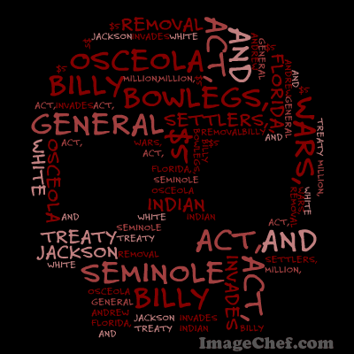
Seminole Wars Product
2) Create 3 word mosaics, one for each of the Seminole Wars using http://www.imagechef.com/ic/word_mosaic/ .
Include at least 10 short statements covering any or all of the Seminole Wars.
Do not use spaces in your statements or use underscores to separate the words.

Slide 18
Seminole Wars Product
Save your word mosaics, movie posters or video games into your teacher’s
Sweden folder. There will be a folder titled Seminole Products and your class name.
Save your file with both first names, number of the war and product choice.
For example; Bob Joe 1 Movie Poster.jpg

