Slide 1
The Status of Women
1848

Slide 2
LEGAL STATUS
Could not own property or wages.
No legal guardianship of children
Unequal pay & employment
Could not vote
Could not serve on juries or testify in court
Could not sue or be sued
Could not speak to groups in public.

Slide 3
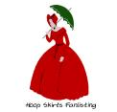
DRESS
Modest- Respectable women were covered head to toe. Layers of clothing could weigh 12-15 lbs. Corsets exerting 80 lbs. of pressure caused internal injuries.

Slide 4
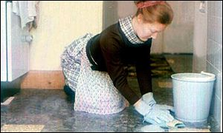
PHYSICAL EXPECTATIONS
Delicate- Women were believed to be very weak and sports were considered too dangerous for them. It was feared that exercise would masculinize women and give them “gymnasium face”. Most doctors recommended housework as the only safe exercise.

Slide 5
EDUCATION
College was not allowed and educated women learned to hide their intellect.
Women’s brains were considered small and inferior to men's. Doctors warned girls and women against difficult subjects for fear of brain fever.
Women were taught to be submissive and obedient.

Slide 6
RELIGION
Women were not allowed to pray publicly.
The church often used the Bible as a way to keep women in there place.
- “Wives, submit yourselves unto your husbands…”
- “Let women suffer in silence.”

